Slide 1



Making better conservation decisions
Jeffrey Hanson
jeffrey.hanson@uqconnect.edu.au
jeffrey-hanson.com

Slide 2






Acknowledgements
Adam Marques
Ana Veríssimo
Caitlyn Proctor
Carlo Rondinini
Cynthia Riginos
Emma Hudgins
Francesco Ficetola
Graeme Buchanan
Guillermo Velo-Antón
Hugh Possingham
Iadine Chadès
Íñigo Martínez-Solano
Jenny McCune
Jonathan Rhodes
Joseph Bennett
Matt Watts
Matthew Strimas-Mackey
Miguel Camacho-Sanchez
Nina Morell
Peter Arcese
Richard Fuller
Richard Schuster
Silvia Carvalho
Stuart Butchart

Slide 3
Now
Biodiversity
Status quo
2000
Future

Slide 4
Now
How do we
get here?
Biodiversity
Status quo
2000
Future

Slide 5
How can we get a better conservation decision?
(1) Better algorithms
(2) Better data
(3) Better surrogates

Slide 6



Ecological surveys
Distribution maps
Priority areas
Biodiversity
2000
Future
Data
Information
Plan
Outcome
Objectives
Constraints

Slide 7
Ecological surveys
Distribution maps
Priority areas
Biodiversity
2000
Future
Data
Information
Plan
Outcome
Better
algorithms
Better
outcome
Objectives
Constraints

Slide 8
Reserve selection
Features
Notes:
- not all remaining habitat can be preserved
- achieve conservation objectives for minimal cost
- modern systematic conservation planning primarily focusses on representing species
- however, this ignores intra-specific biodiversity
<number>

Slide 9
Reserve selection
Planning units

Slide 10
Reserve selection
?
?
?
?
?
?

Slide 11
Reserve selection

Slide 12





Heuristic
algorithm
Meta-heuristic
algorithms
Exact
algorithms
Estimate of best quality
Quality
Different
solutions
Different
solutions
Different
solutions

Slide 13




prioritizr R package
What you value
Input to solver
Data
Mathematical
optimization
problem
Biodiversity
Land use
Economic
Solve problem
What the solution
must (or mustn't) do
Maps
Statistics
Hanson et al. 2020 CRAN

Slide 14
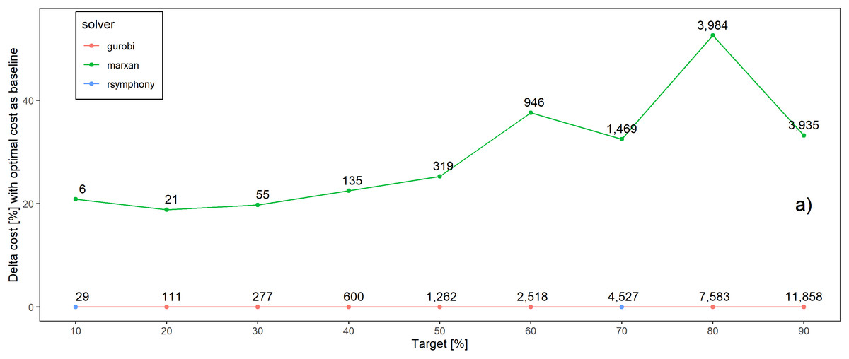
Better solutions
Schuster et al. 2020 PeerJ

Slide 15
…and faster too!
183x slower
52x slower
Time difference
Schuster et al. 2020 PeerJ

Slide 16
What about other conservation problems?

Slide 17



Feature data
Phylogenetic data
Stakeholder weights
Project prioritization
Project data
Recovery projects

Slide 18




Feature data
Phylogenetic data
Stakeholder weights
Project prioritization
Project data
Cost data
Actions
$
$$
$$$
Recovery projects
$0

Slide 19
Feature data
Phylogenetic data
Stakeholder weights
Project prioritization
Project data
Cost data
Actions
$
Success
$$
90%
$$$
20%
Recovery projects
$0
50%
100%

Slide 20
Feature data
Phylogenetic data
Stakeholder weights
Project prioritization
Project data
Cost data
Actions
Persistence (%)
$
Success
$$
90%
95%
$$$$$
20%
10%
Recovery projects
$0
50%
70%
100%
40%
9%
65%

Slide 21
Feature data
Phylogenetic data
Stakeholder weights
Project prioritization
Project data
Cost data
Actions
Persistence (%)
$
Success
$$
90%
95%
$$$
20%
10%
Recovery projects
$0
50%
70%
Budget
$$$
100%
40%
9%
65%

Slide 22
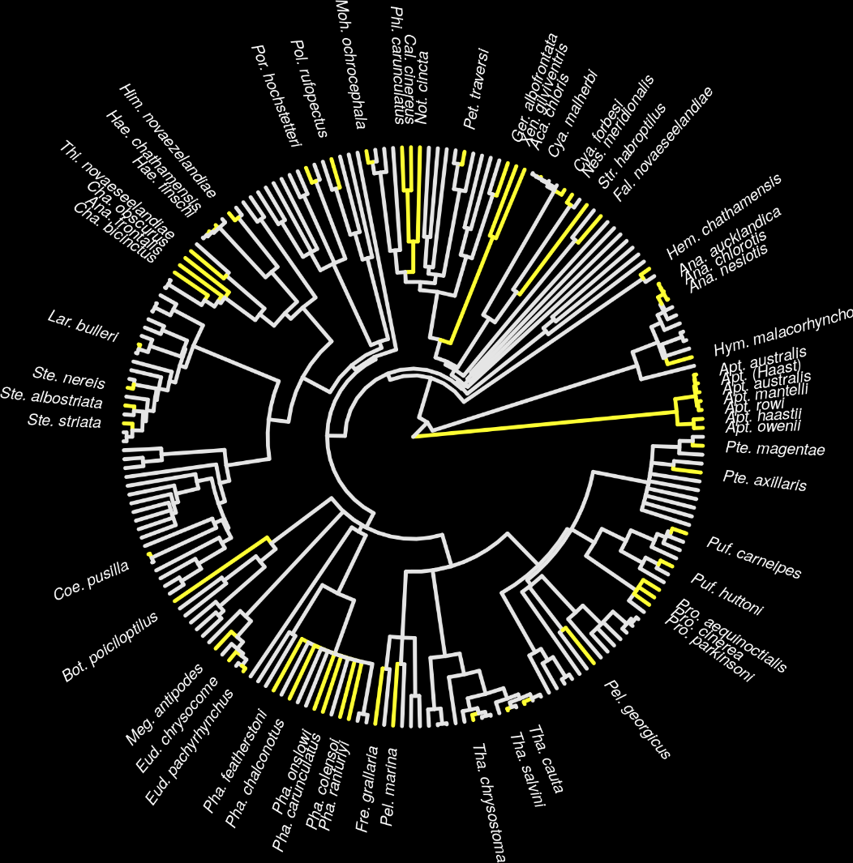
New Zealand case study
Projects for 62 imperilled bird species
1,218 different actions
Many actions shared between projects for different species
Hanson et al. 2019 Methods Ecol Evol

Slide 23
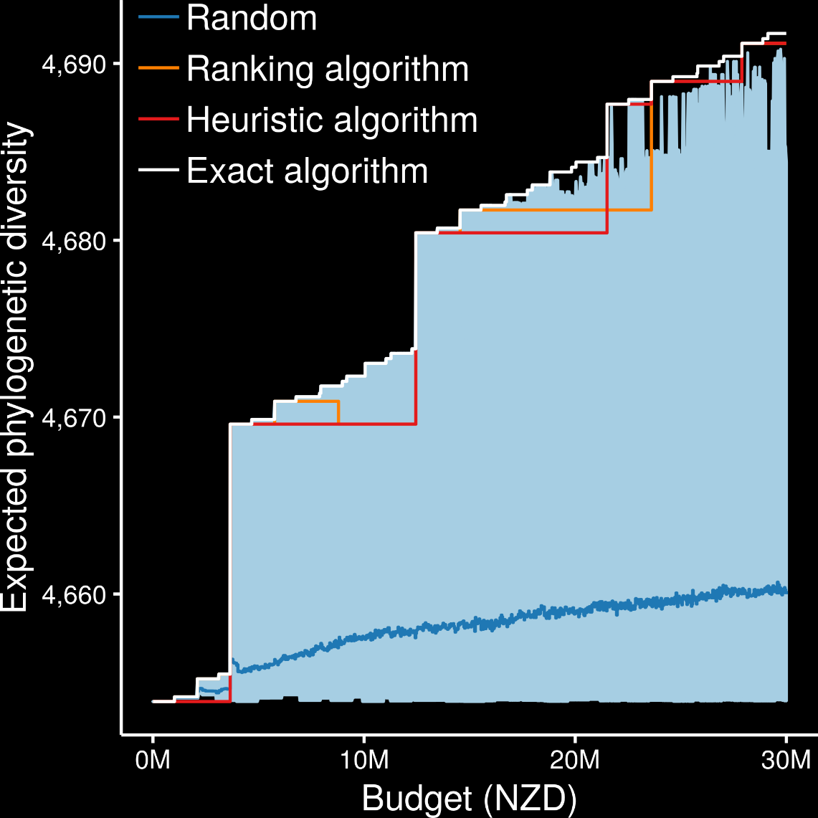
Exact algorithms always best
Ranking and heuristic algorithms sometimes produced optimal plans
Randomly funding projects sometimes produced better plans than ranking and heuristic algorithms
oppr R package
Hanson et al. 2019 Methods Ecol Evol

Slide 24
How can we get a better conservation decision?
(1) Better algorithms
(2) Better data
(3) Better surrogates

Slide 25
Ecological surveys
Distribution maps
Priority areas
Biodiversity
2000
Future
Data
Information
Plan
Outcome
Objectives
Constraints

Slide 26

Ecological surveys
Distribution maps
Priority areas
Biodiversity
2000
Future
Data
Information
Plan
Outcome
Better
understanding
of biodiversity
Better
plan
Better
outcome
Genetic samples
Objectives
Constraints
Notes:
<number>

Slide 27
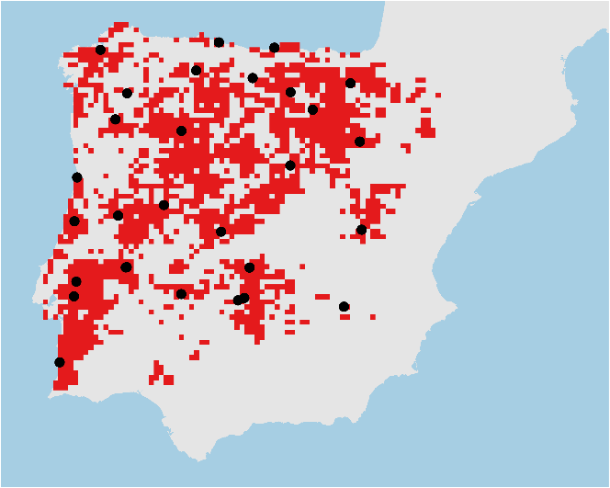
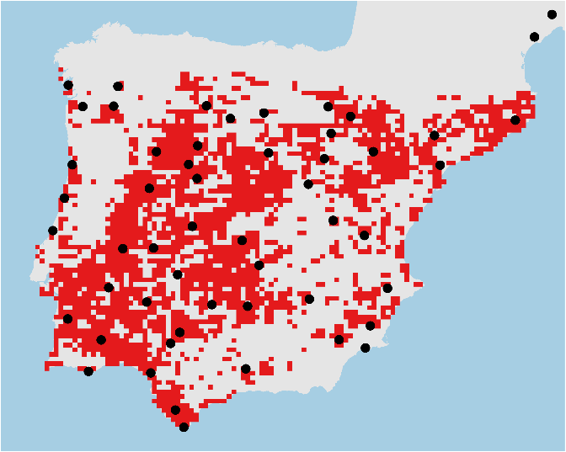
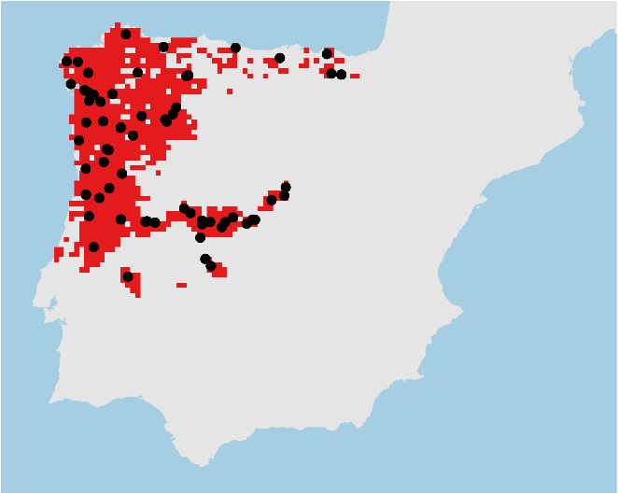

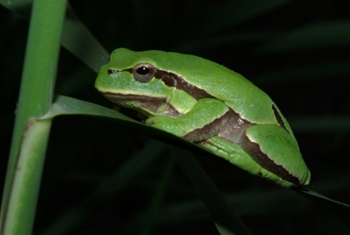
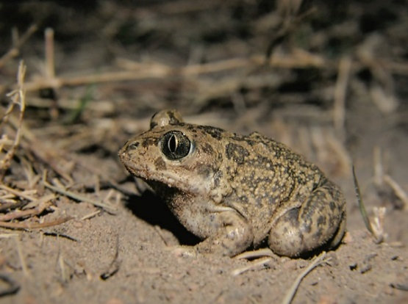
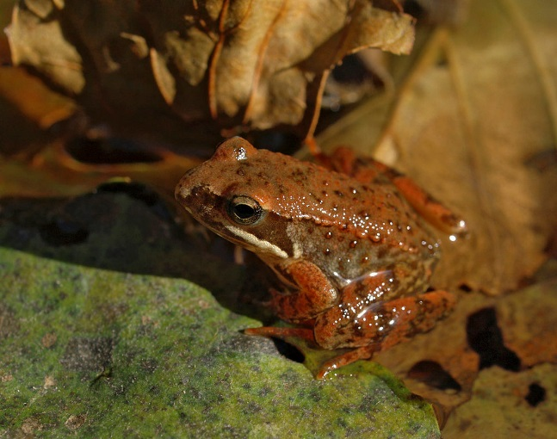
Conservation planning for adaptive and neutral evolutionary processes
Hyla molleri
Pelobates cultripes
Rana iberica

Slide 28
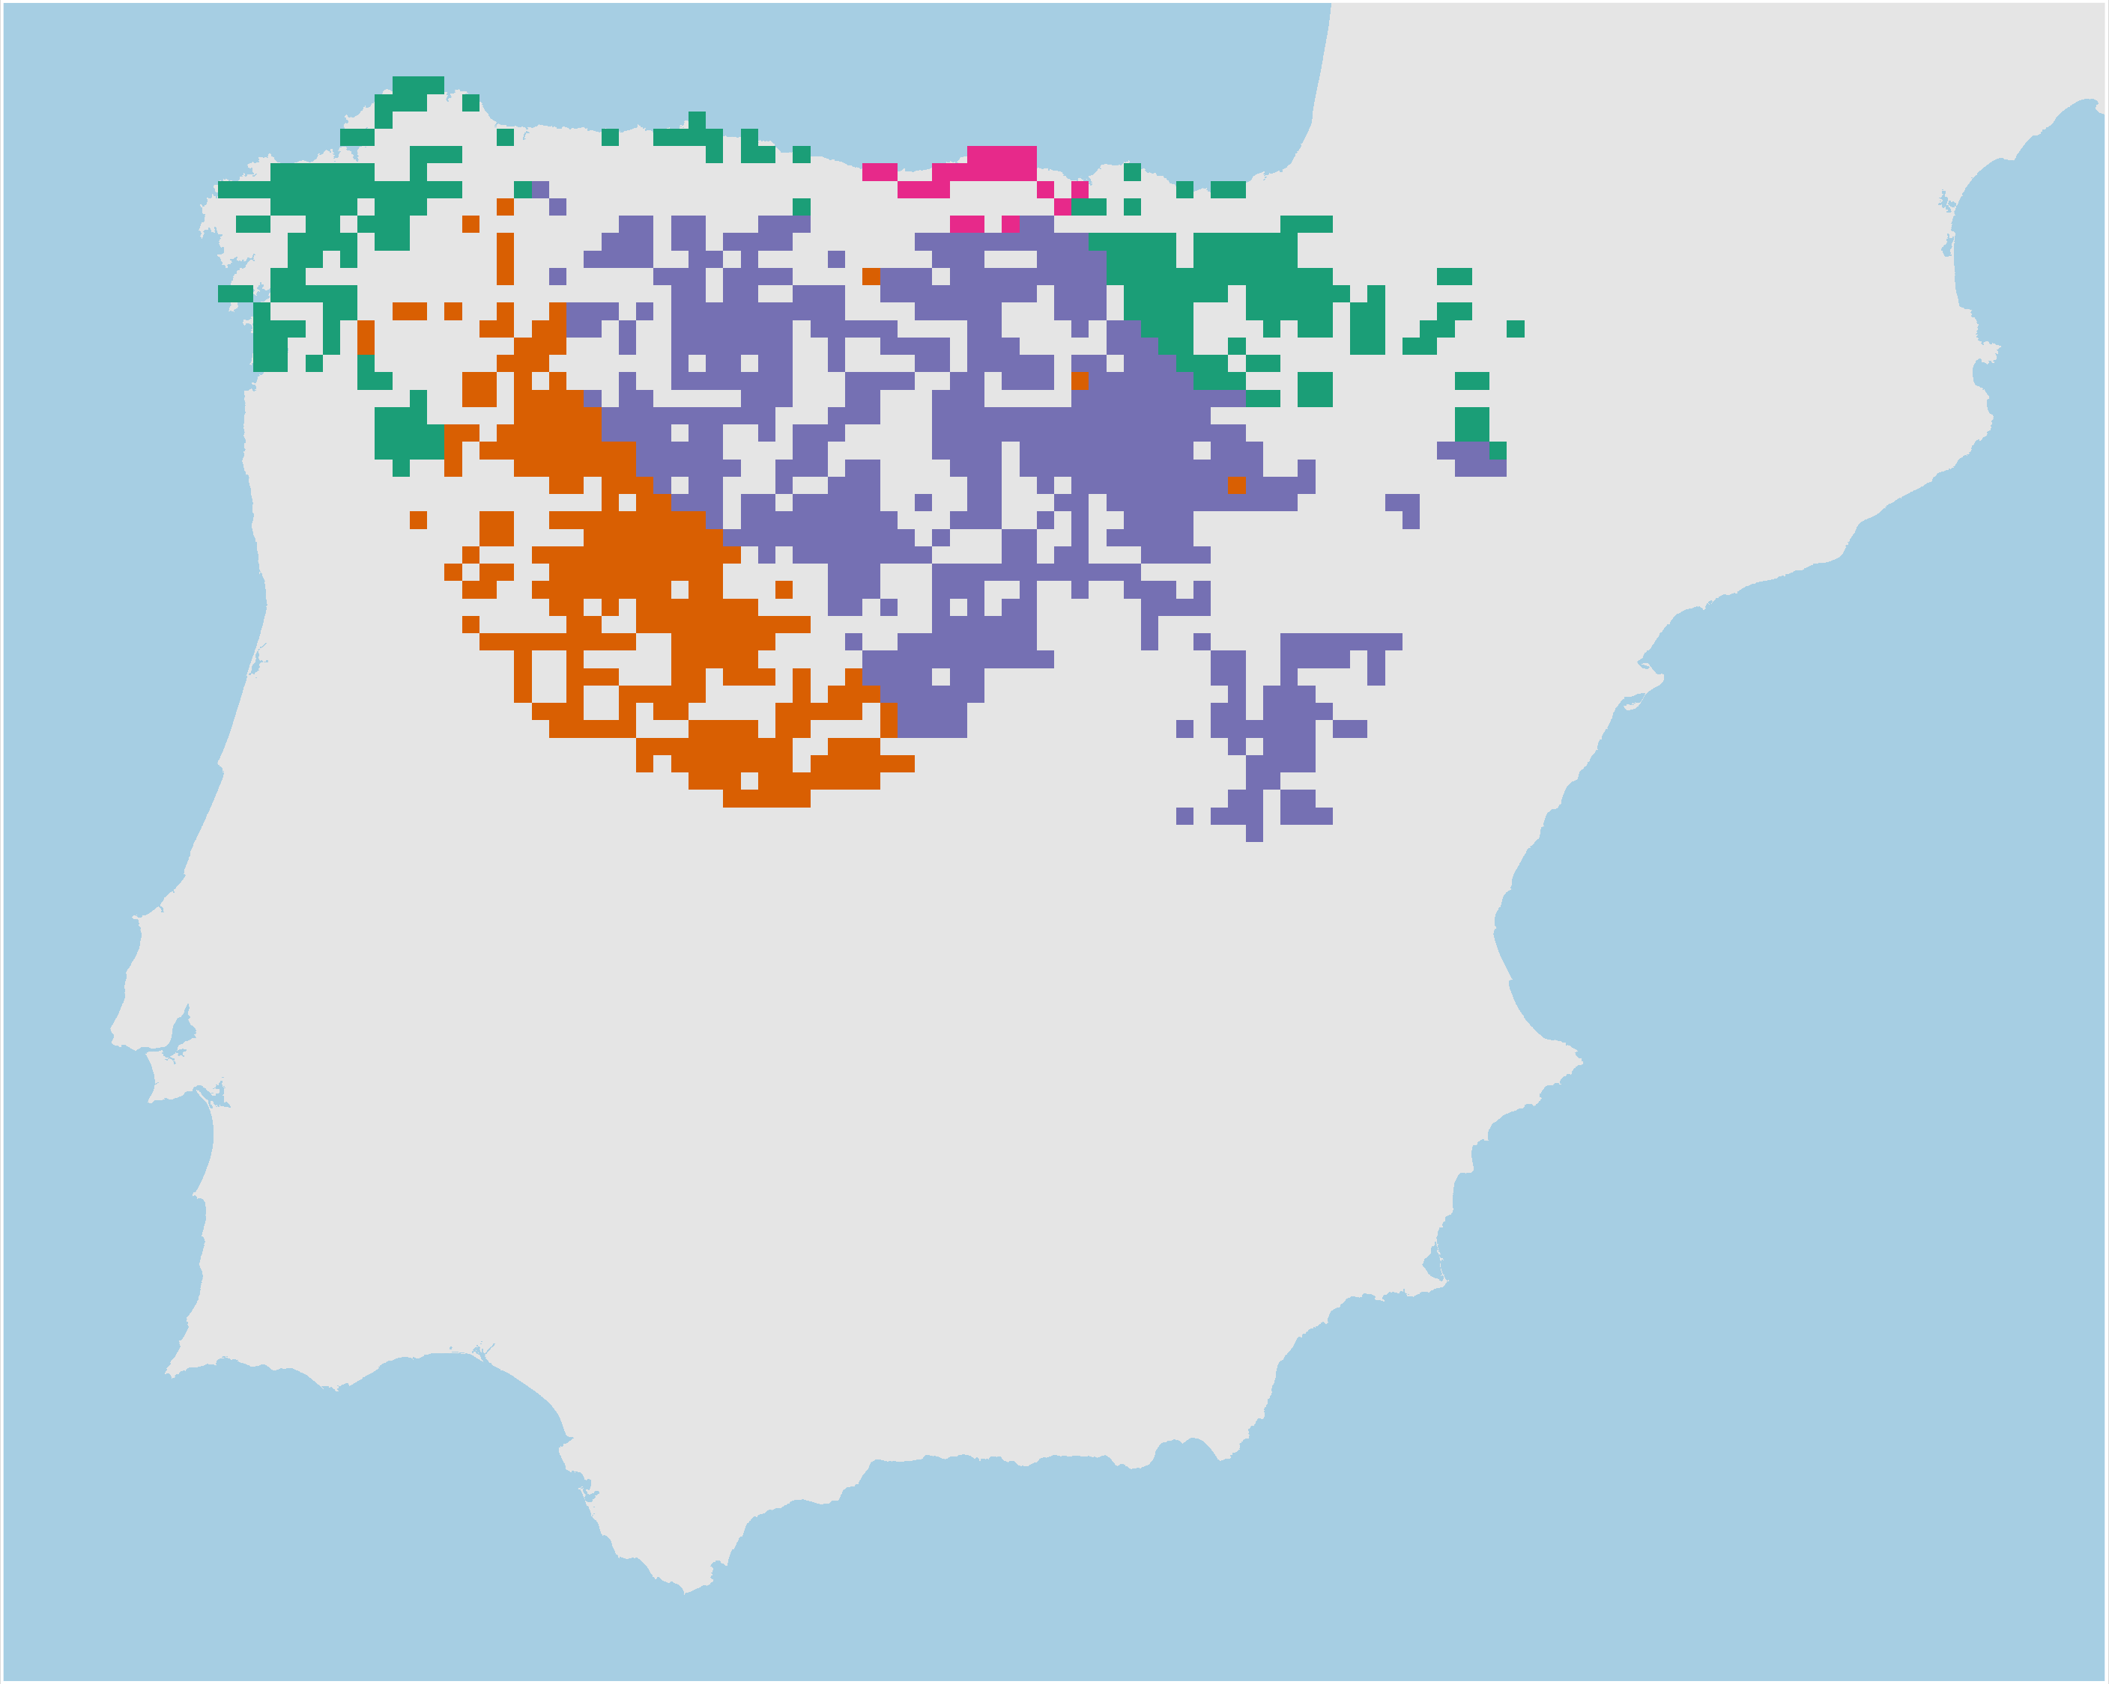
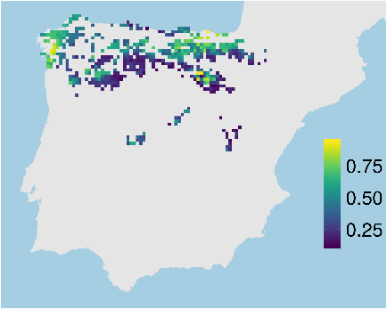
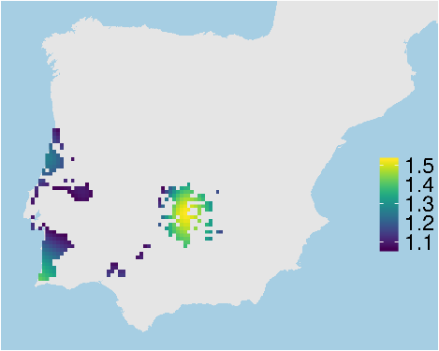
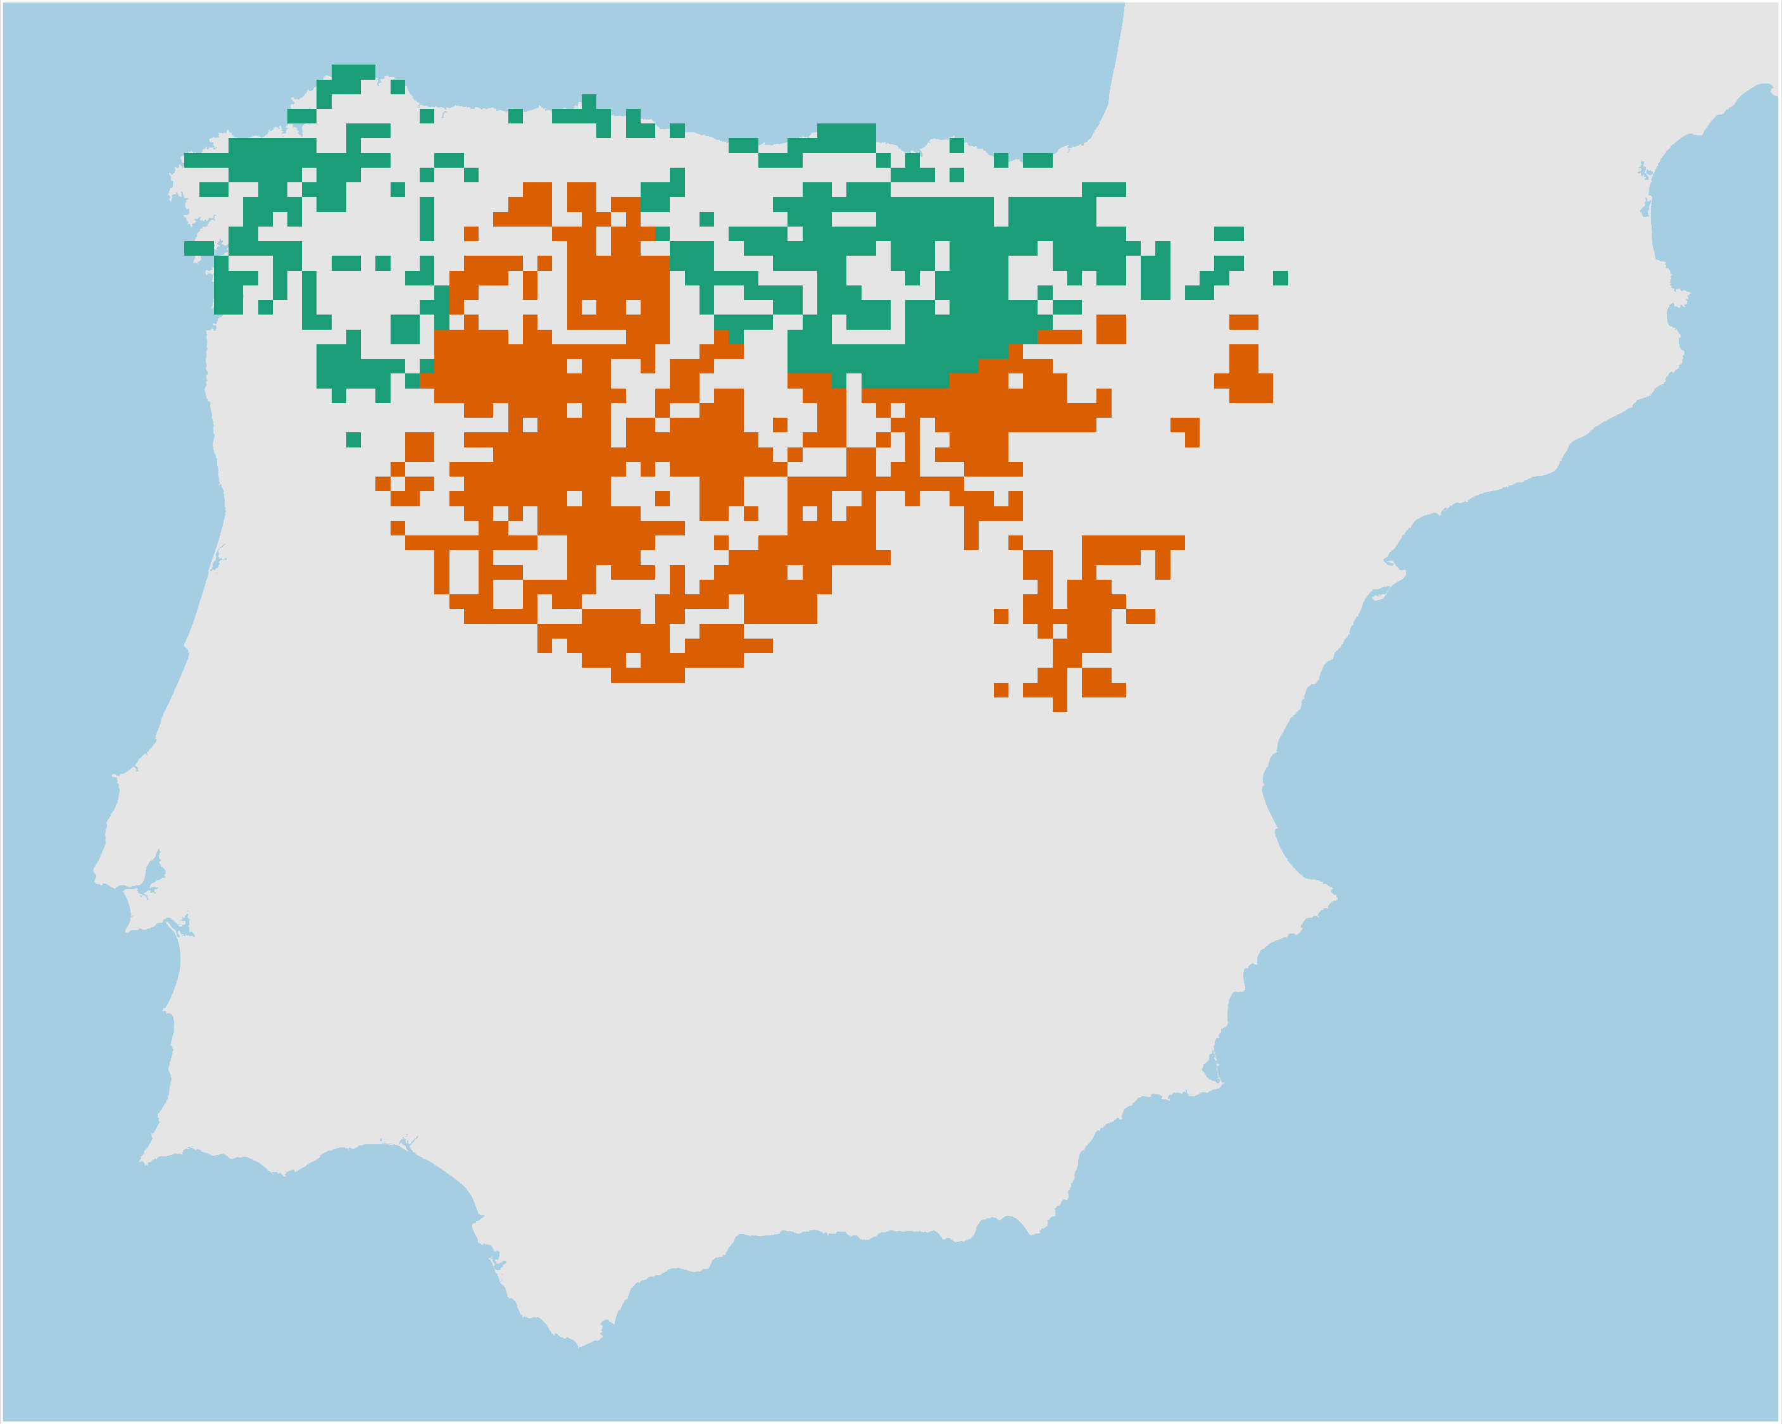
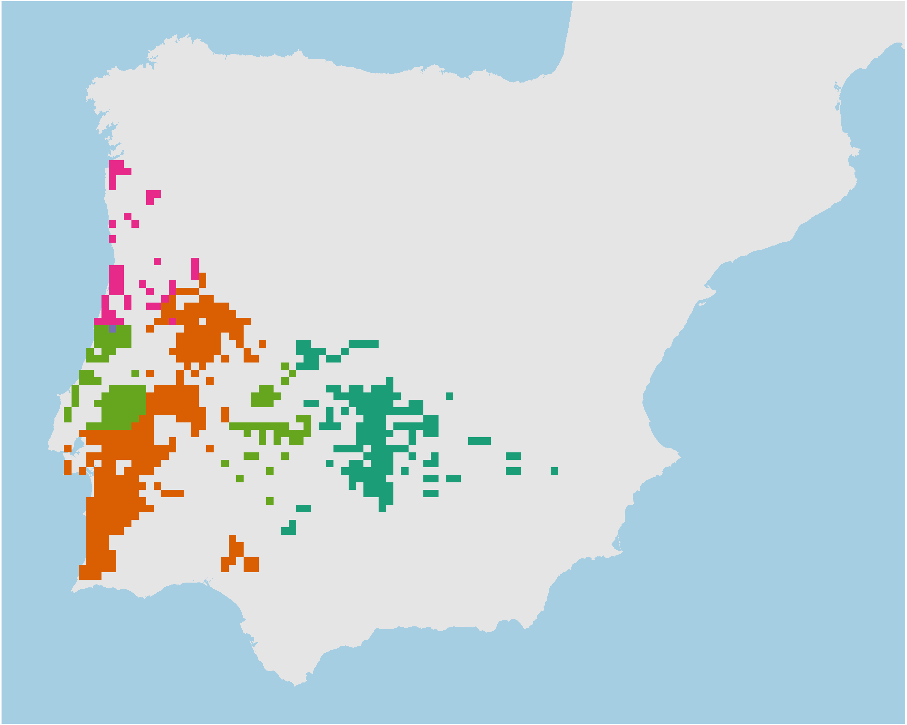
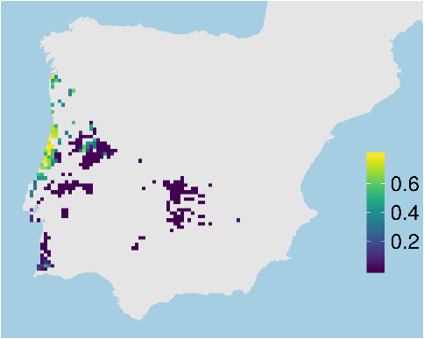
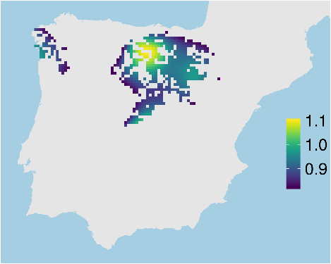
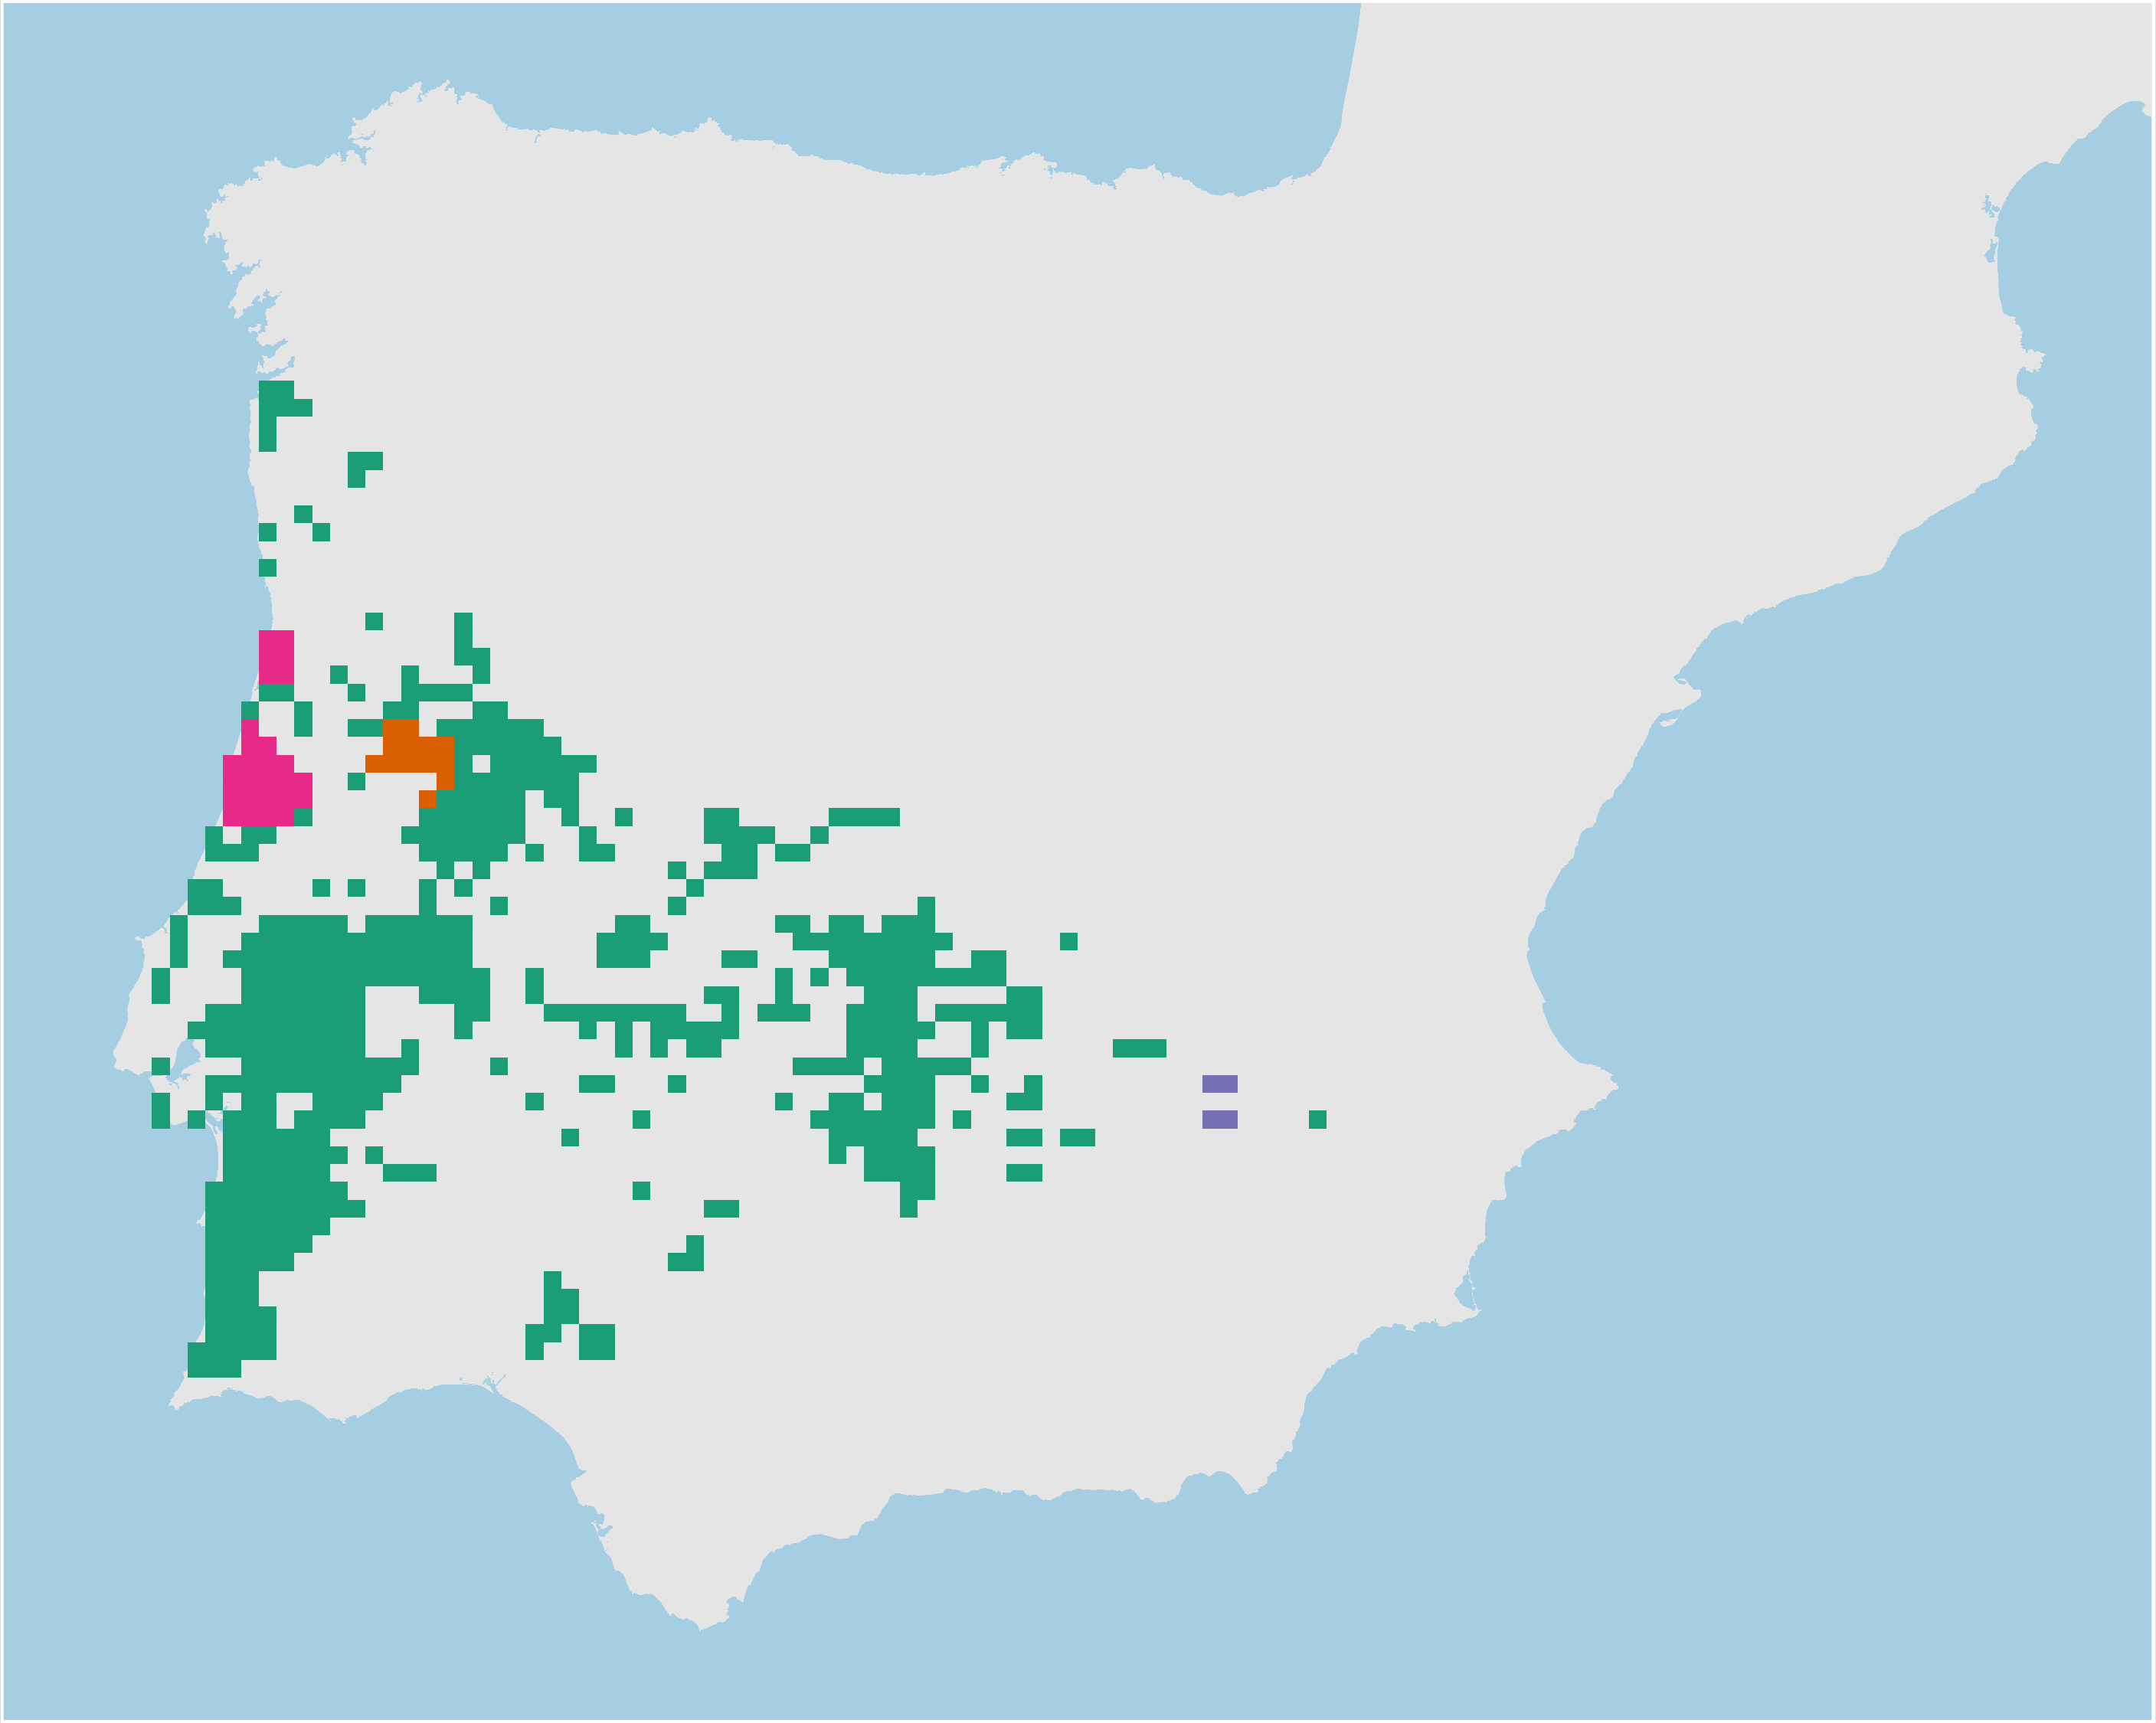
Adaptive processes
Neutral processes
Hyla
molleri
Adaptive
clusters
Climate
refugia
Individual
heterozygosity
Neutral
clusters

Slide 29
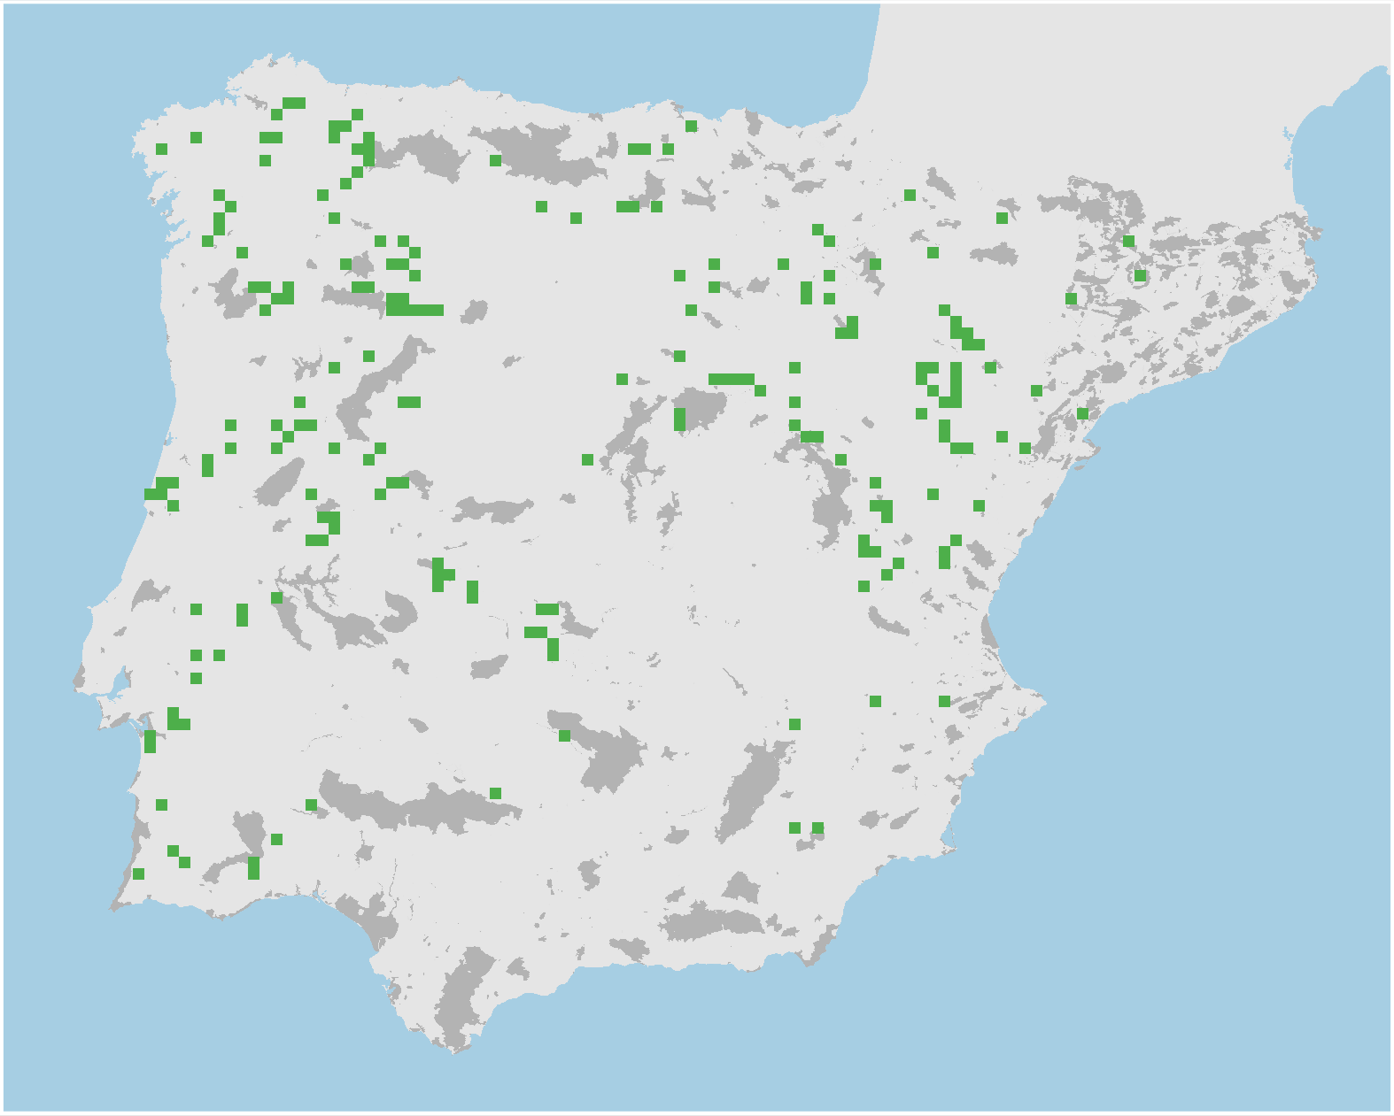
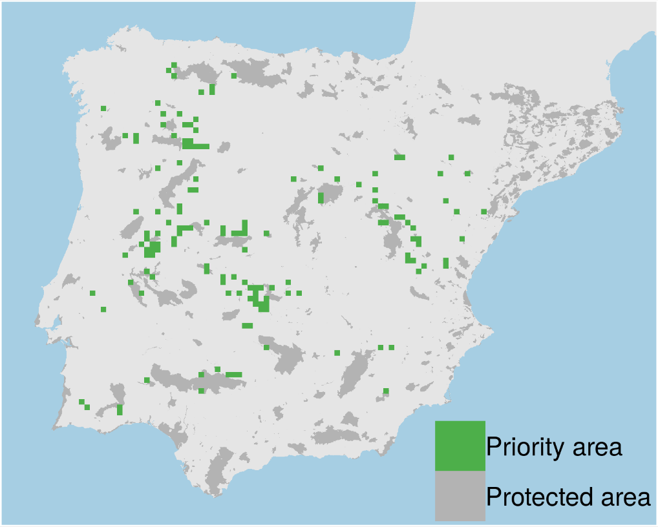
Prioritizations
Plan with evolutionary
attributes
Conventional plan
Only costs 9% less

Slide 30
However, more data isn’t always better…

Slide 31
Ecological surveys
Distribution maps
Priority areas
Biodiversity
2000
Future
Data
Information
Plan
Outcome
Objectives
Constraints

Slide 32
Ecological surveys
Distribution maps
Priority areas
Biodiversity
?
?
?
?
?
?
2000
Future
Data
Information
Plan
Outcome
More
surveys
Better
models
Better
management
Better
outcome
Objectives
Constraints

Slide 33
Ecological surveys
Distribution maps
Prioritization
Biodiversity
?
?
?
?
?
?
?
?
?
?
?
?
2000
Future
Data
Information
Plan
Outcome
More
surveys
Better
models
Poorer
management
Worse
outcome
Objectives
Constraints
Less funding

Slide 34
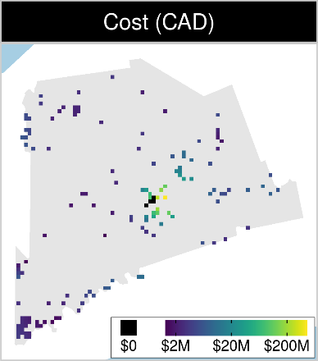
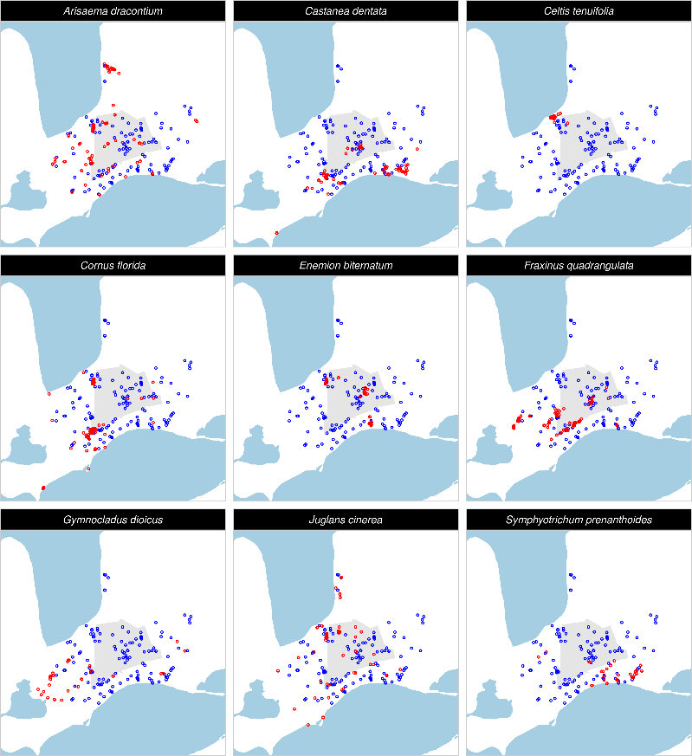
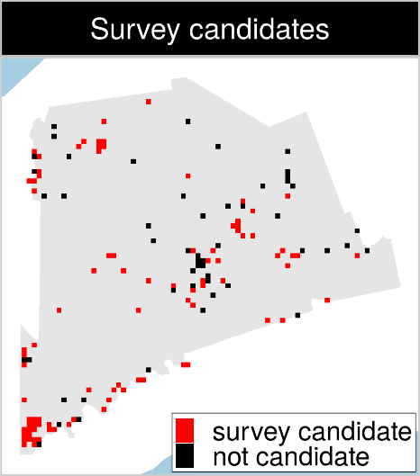
Optimizing ecological surveys for conservation
142 places that could
potentially be acquired for
protected area establishment
90 places that could potentially be surveyed to
improve existing data
9 imperilled plant species
Notes:
<number>

Slide 35
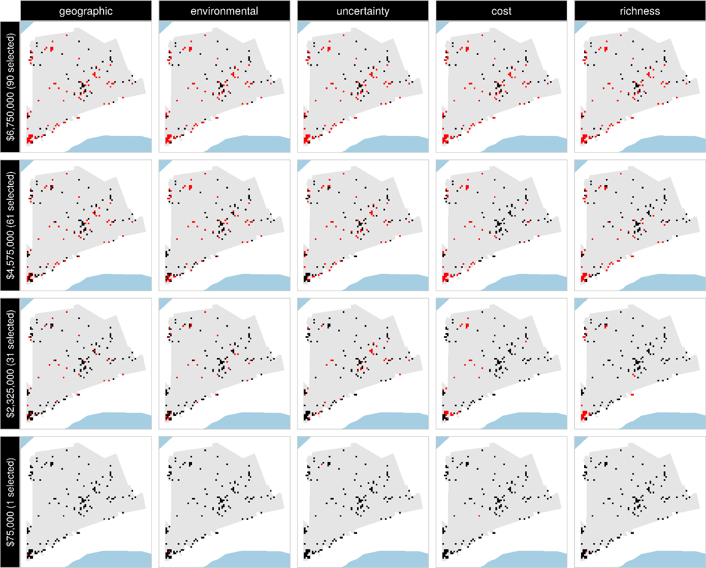
Selected
for survey
Number of places selected for surveys
(amount of funds allocated for collecting extra data)
NOT selected
for survey
Different approaches for designing survey schemes

Slide 36
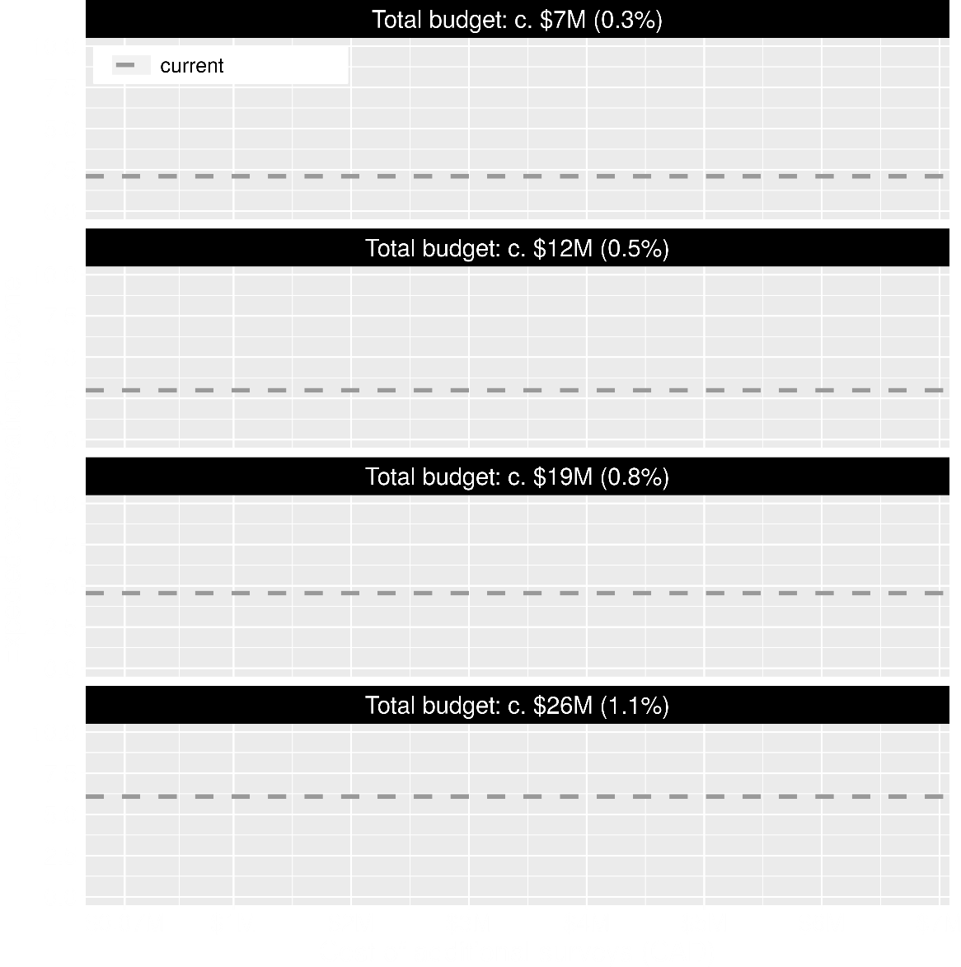
Value of information
Existing data leads to positive outcomes
More budget means better outcomes

Slide 37
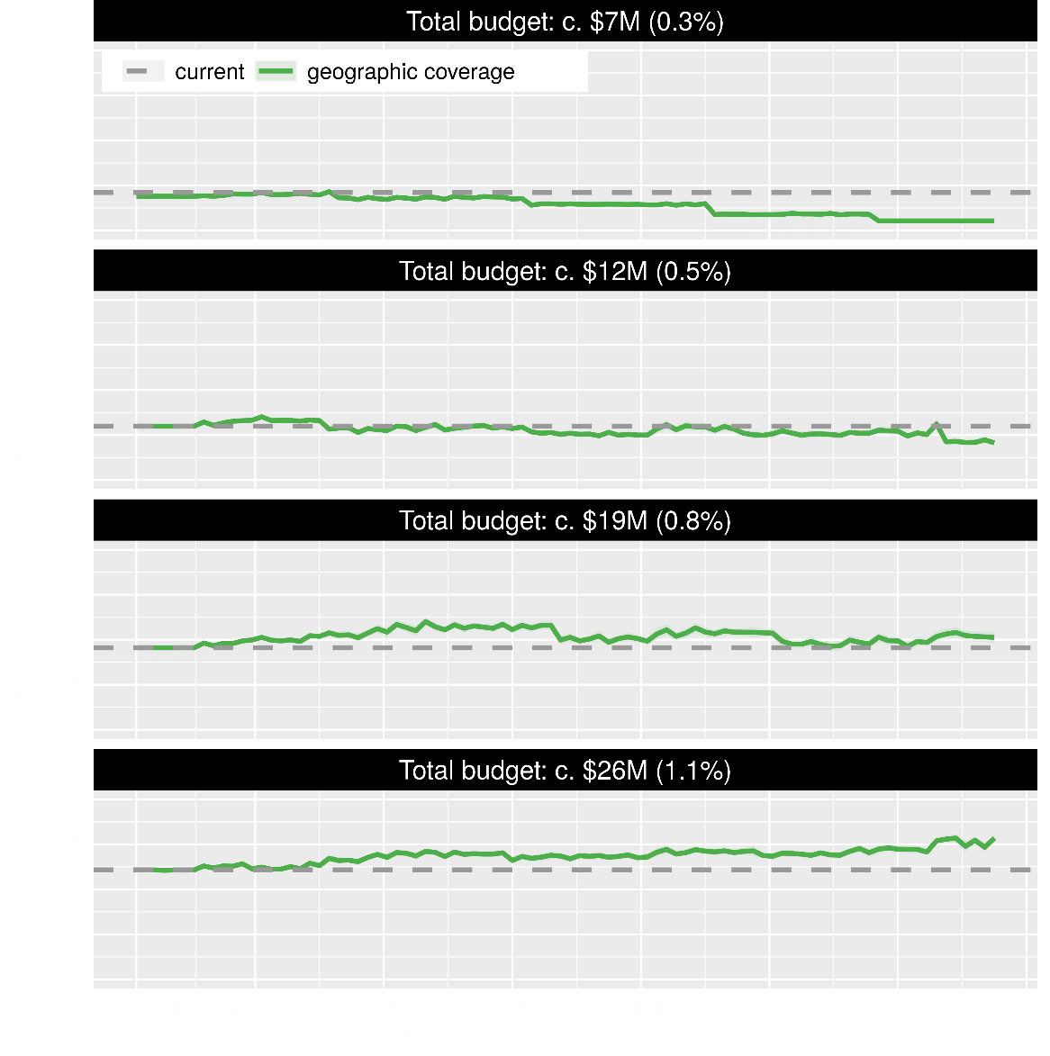
Value of information
Allocating funds for gathering more data can mean worse outcomes
Allocating funds for gathering more data can mean better outcomes too

Slide 38
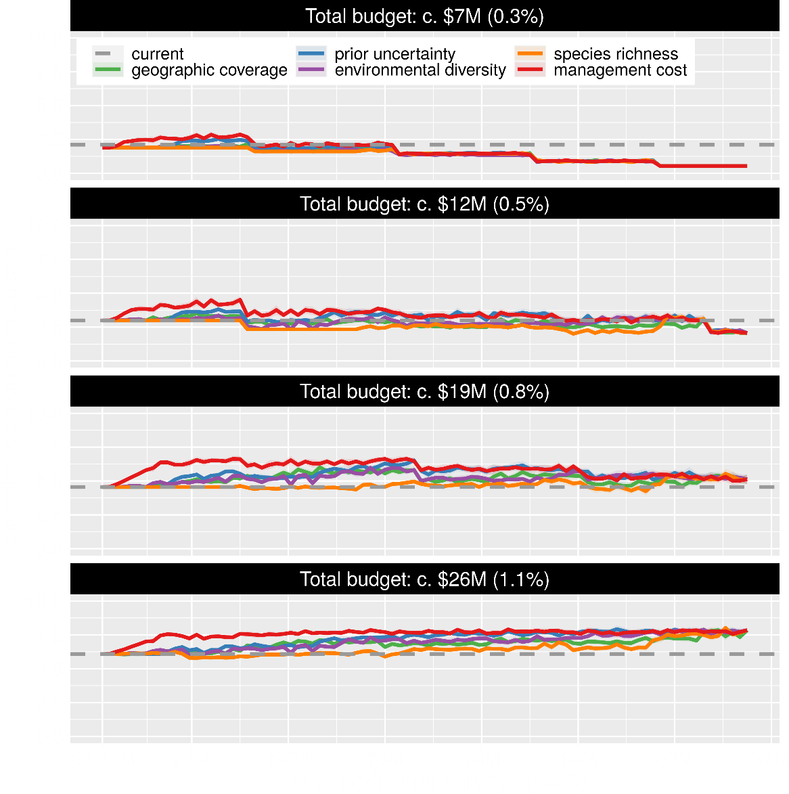
Value of information
Conventional approaches for gathering additional evidence have different performance
Performance of these approaches depends on available funds
All of them could lead to lead to worse outcomes

Slide 39
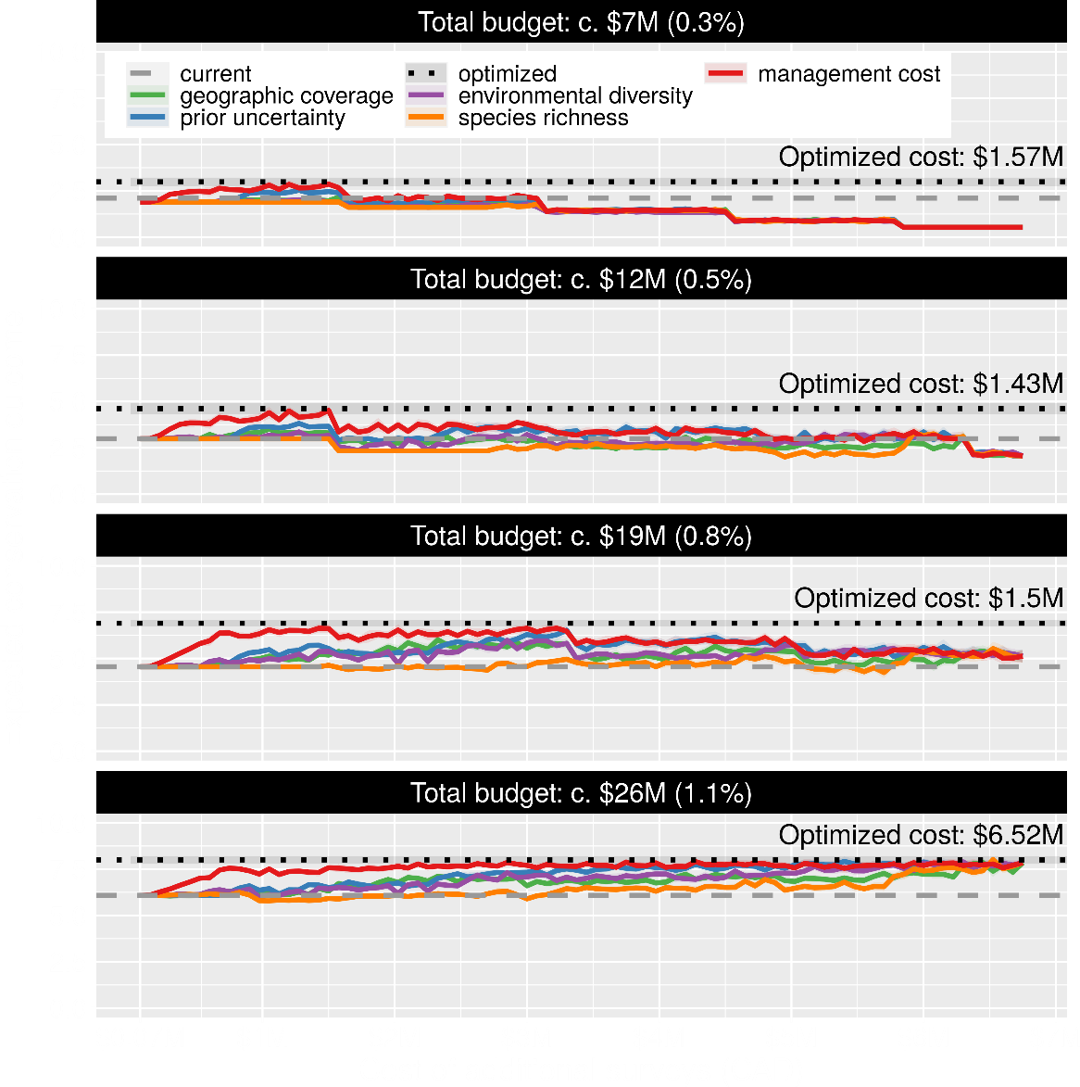
Value of information
Directly maximizing return on investment is best method for additional data
This considers objectives and constraints that underpin conservation plans and their success

Slide 40
How can we get a better conservation decision?
(1) Better algorithms
(2) Better data
(3) Better surrogates

Slide 41
Evolutionary processes
Species range
Population

Slide 42
Evolutionary processes
Species range
Population

Slide 43
Evolutionary processes
Species range
Population

Slide 44
Evolutionary processes
Species range
Population

Slide 45
Ecological surveys
Distribution maps
Priority areas
Biodiversity
2000
2100
Data
Information
Plan
Outcome
Really good
understanding
of biodiversity
Better
plan
Better
outcome
Genetic samples
Objectives
Constraints
Notes:
<number>

Slide 46
Ecological surveys
Distribution maps
Priority areas
Biodiversity
2000
2100
Data
Information
Plan
Outcome
Good enough
understanding
of biodiversity
Better
plan
Better
outcome
Environment data
Cold
Objectives
Constraints
Hot
Notes:
<number>

Slide 47
Can we use environmental and geographic variables as surrogates of genetic variation for conservation planning?

Slide 48
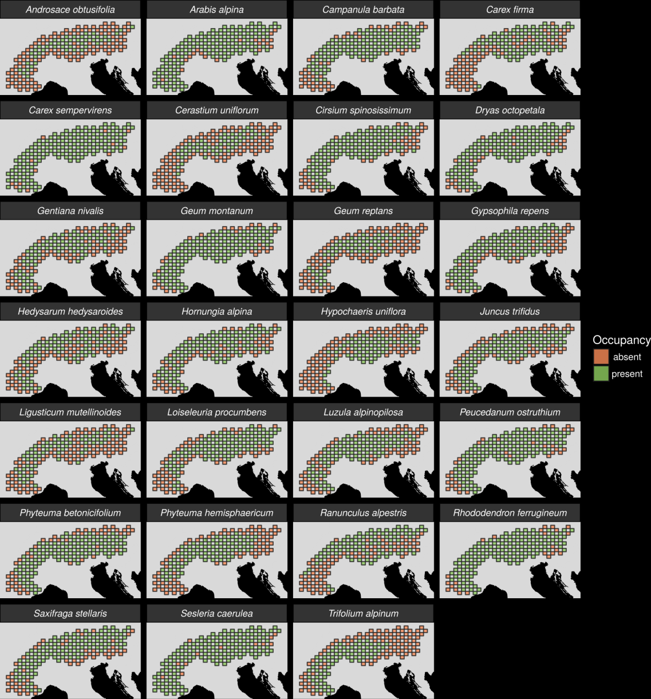
27 plant species
Different dispersal
Different life-histories
Different niches
AFLP markers
Hanson et al. 2017 PNAS

Slide 49
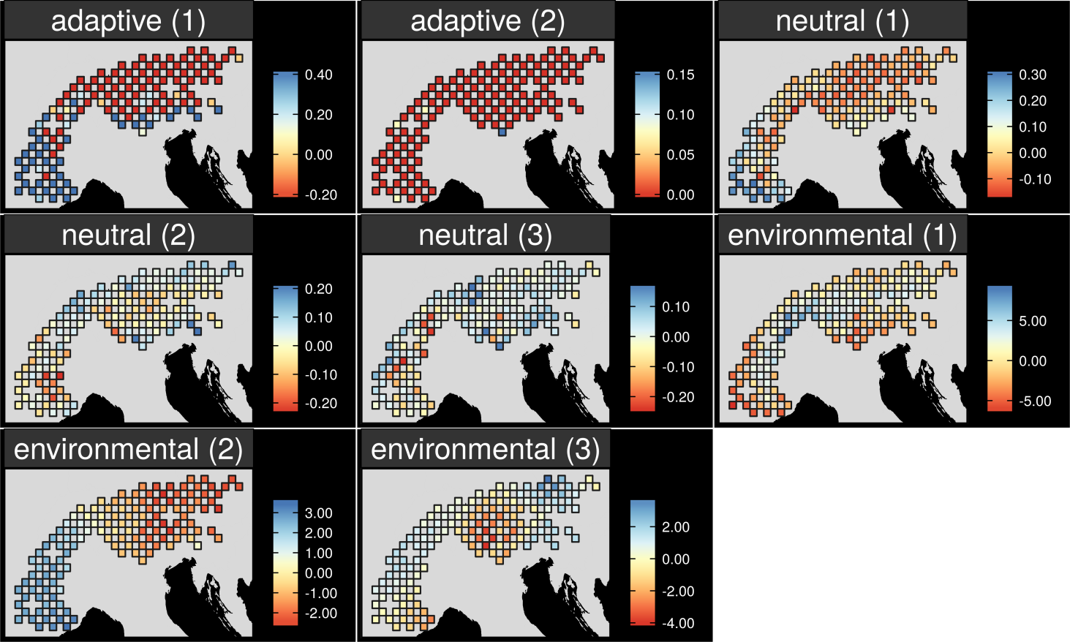
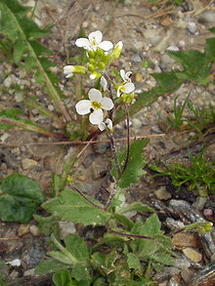
Map intra-specific variation
Arabis alpina
Hanson et al. 2017 PNAS
Notes:
<number>

Slide 50
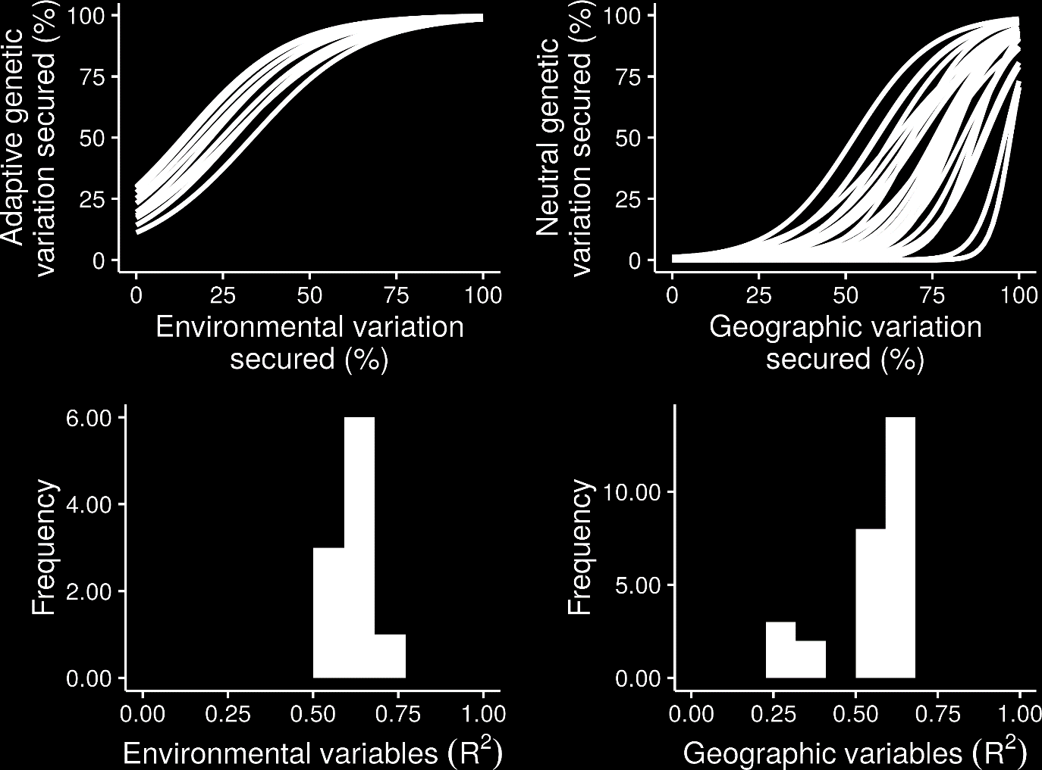
What is the relationship?
Hanson et al. 2017 PNAS

Slide 51
What is the relationship?
Hanson et al. 2017 PNAS

Slide 52
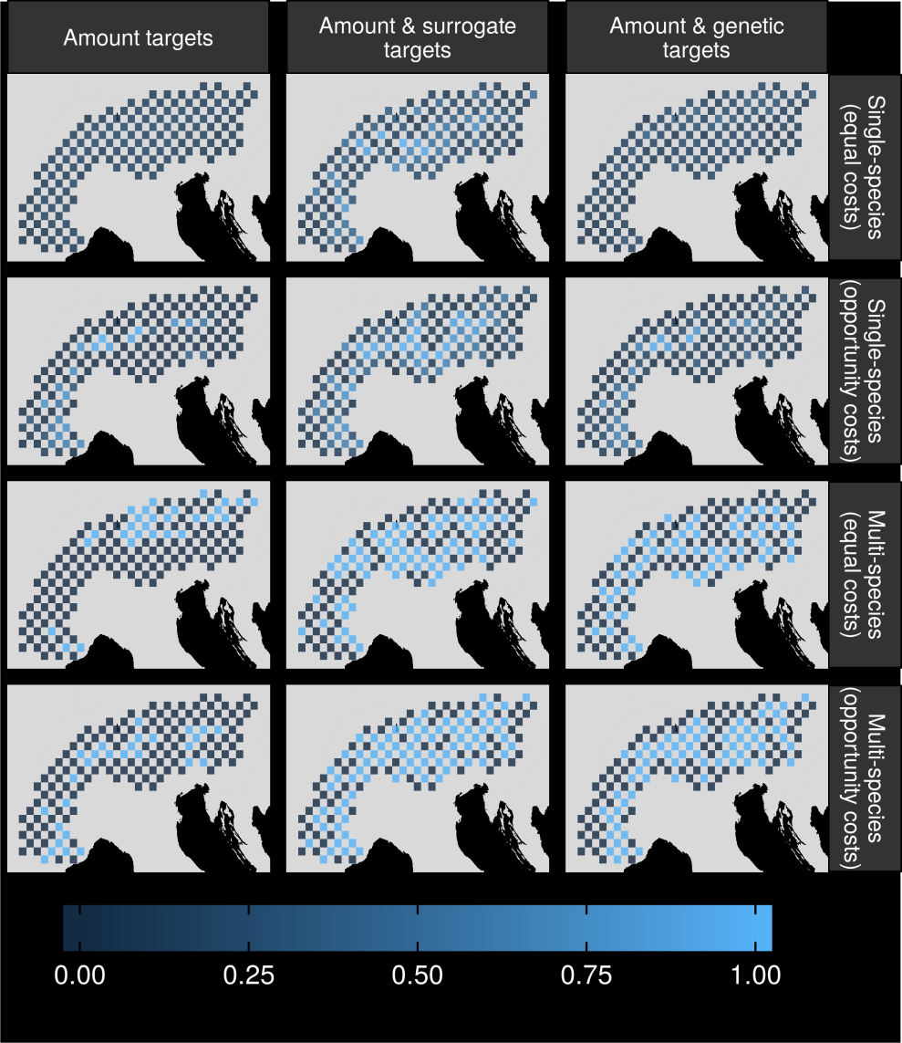
Can surrogates inform our decisions?
Hanson et al. 2017 PNAS

Slide 53
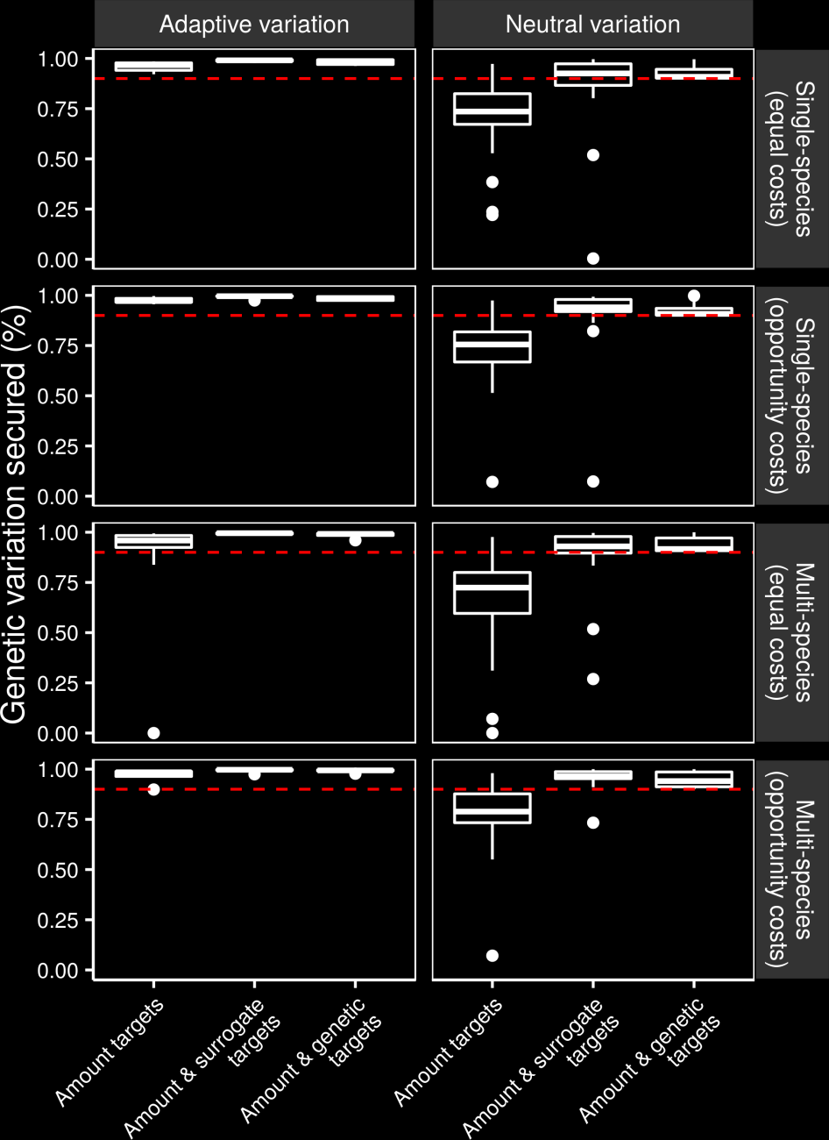
Can we make better decisions using surrogates?
Hanson et al. 2017 PNAS

Slide 54
Can we make better decisions using surrogates?
Hanson et al. 2017 PNAS

Slide 55
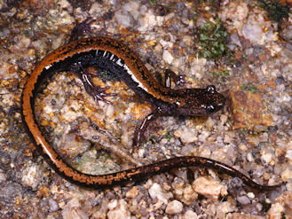
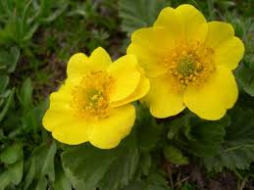
Surrogate performance
Performance might be different in other environments
Performance may depend on species’ dispersal mechanisms
No guarantees!

Slide 56
Assuming environmental surrogates work, what could that mean?

Slide 57
Global conservation of species niches
9,670 bird, 5,070 mammal, 5,197 amphibian species
5 × 5 km maps delineating suitable habitat
Split each species’ distribution into 10 “environmental” partitions
Habitat targets set following standard approaches
Hanson et al. 2020 Nature

Slide 58
Italian Agile Frog
Hanson et al. 2020 Nature

Slide 59
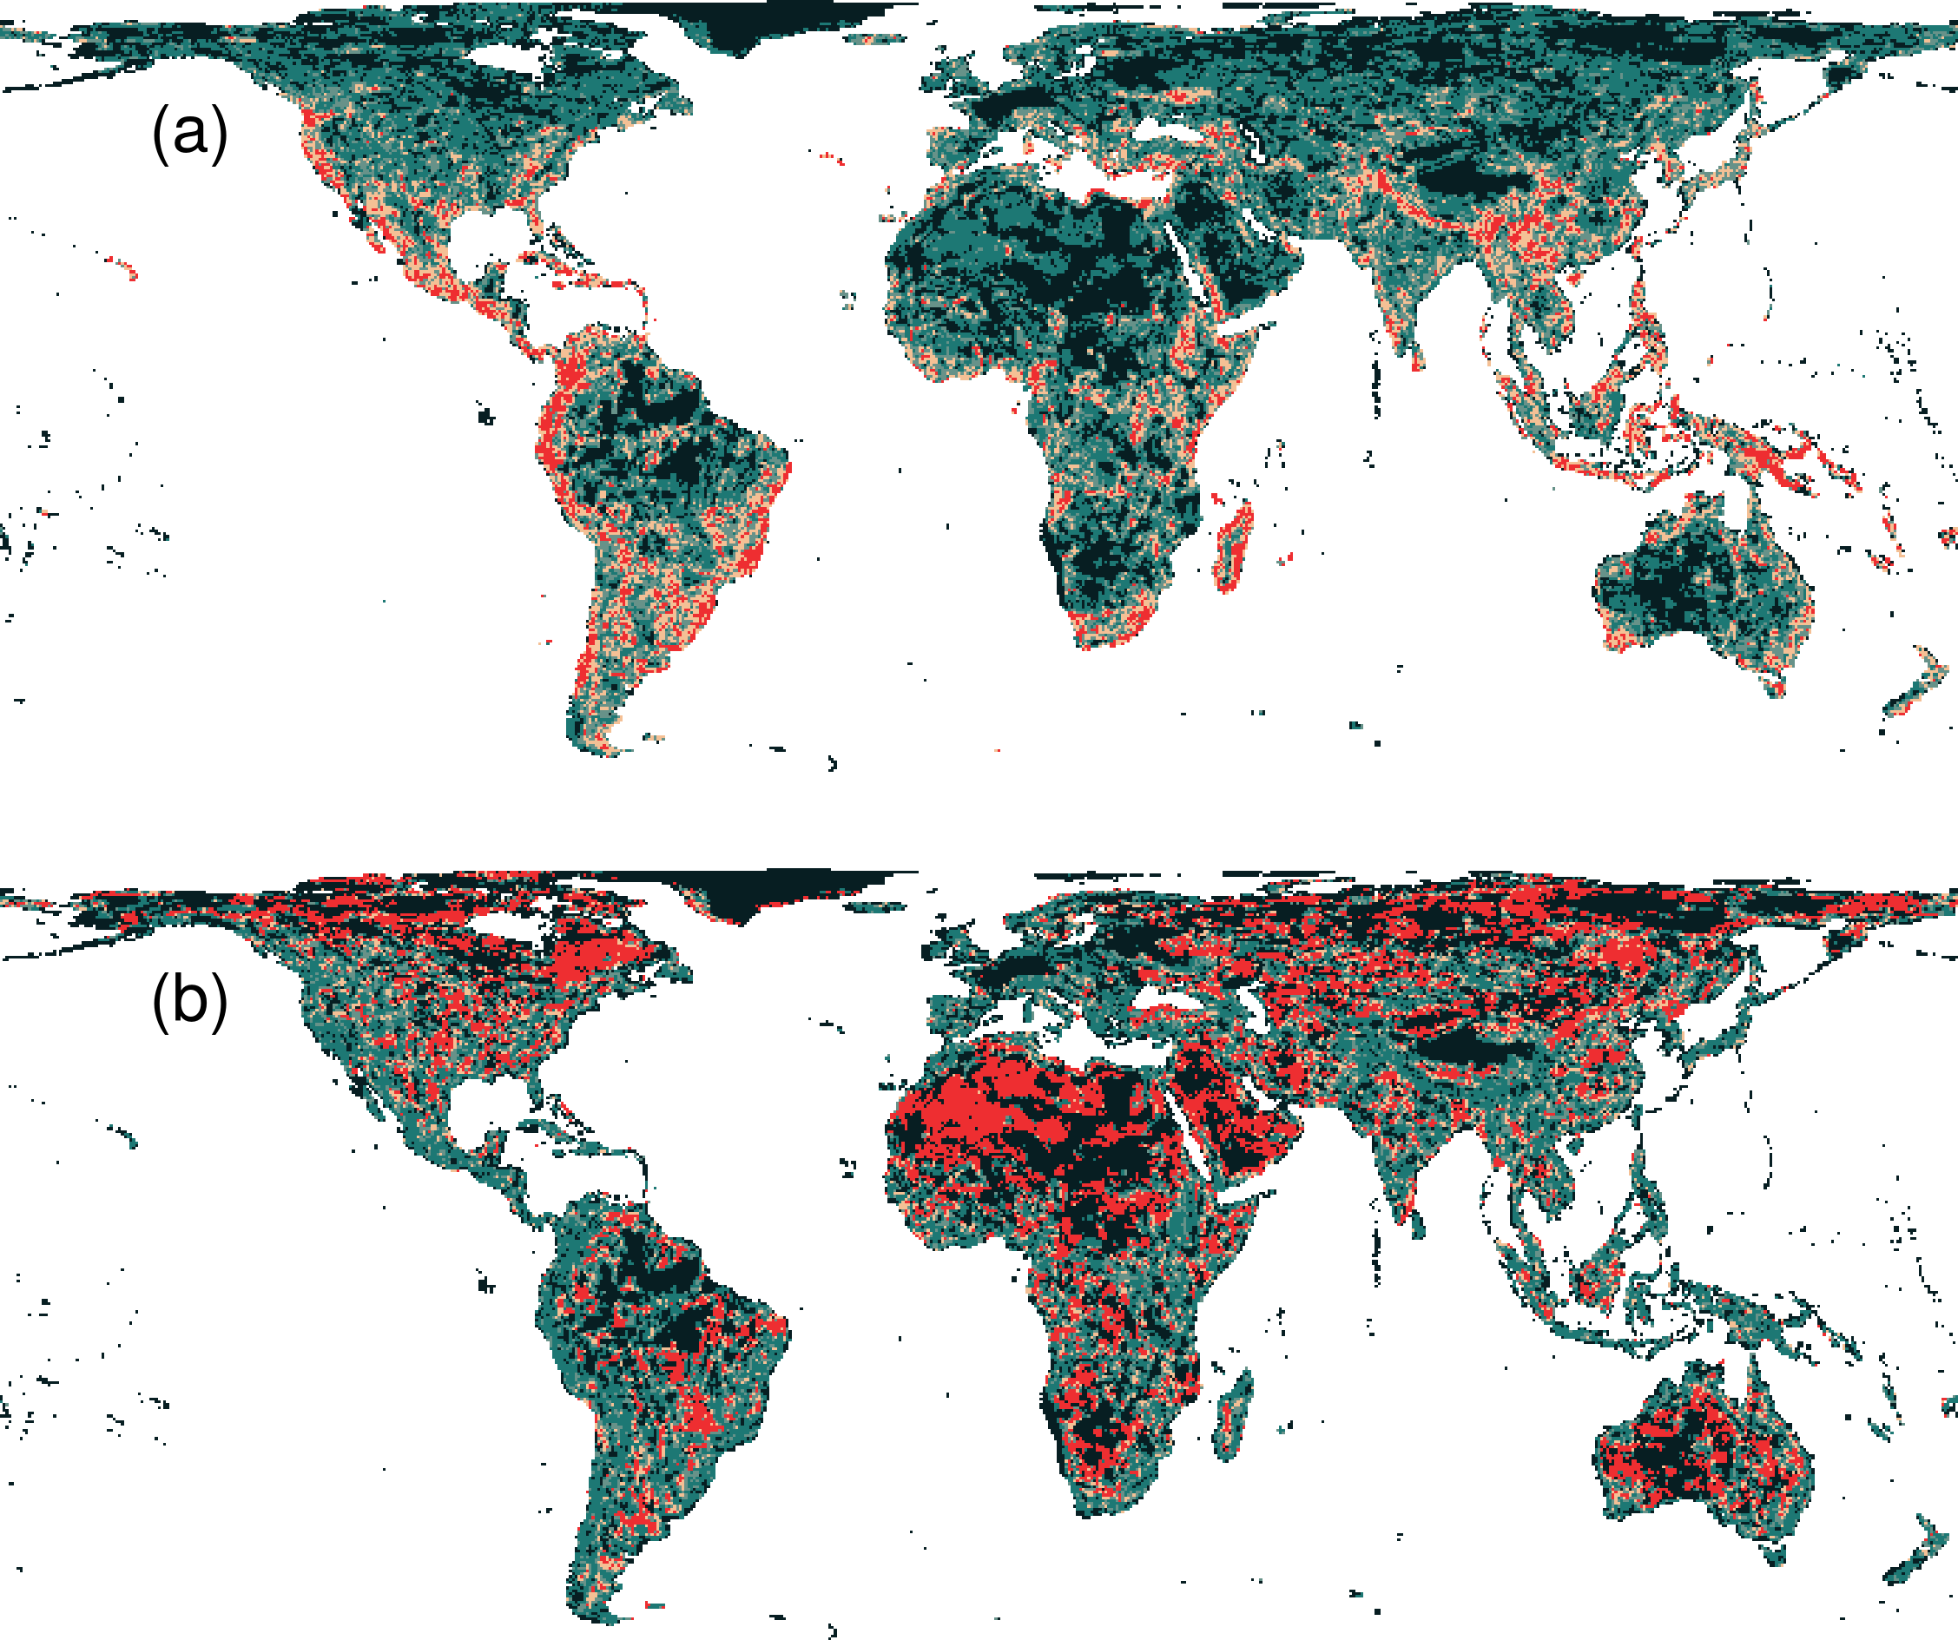
Prioritization for realized niches
35.9 % of the Earth’s land needed to complement existing protected areas
Biodiversity hotspots are critically important
Conservation efforts needed across the planet
Hanson et al. 2020 Nature

Slide 60
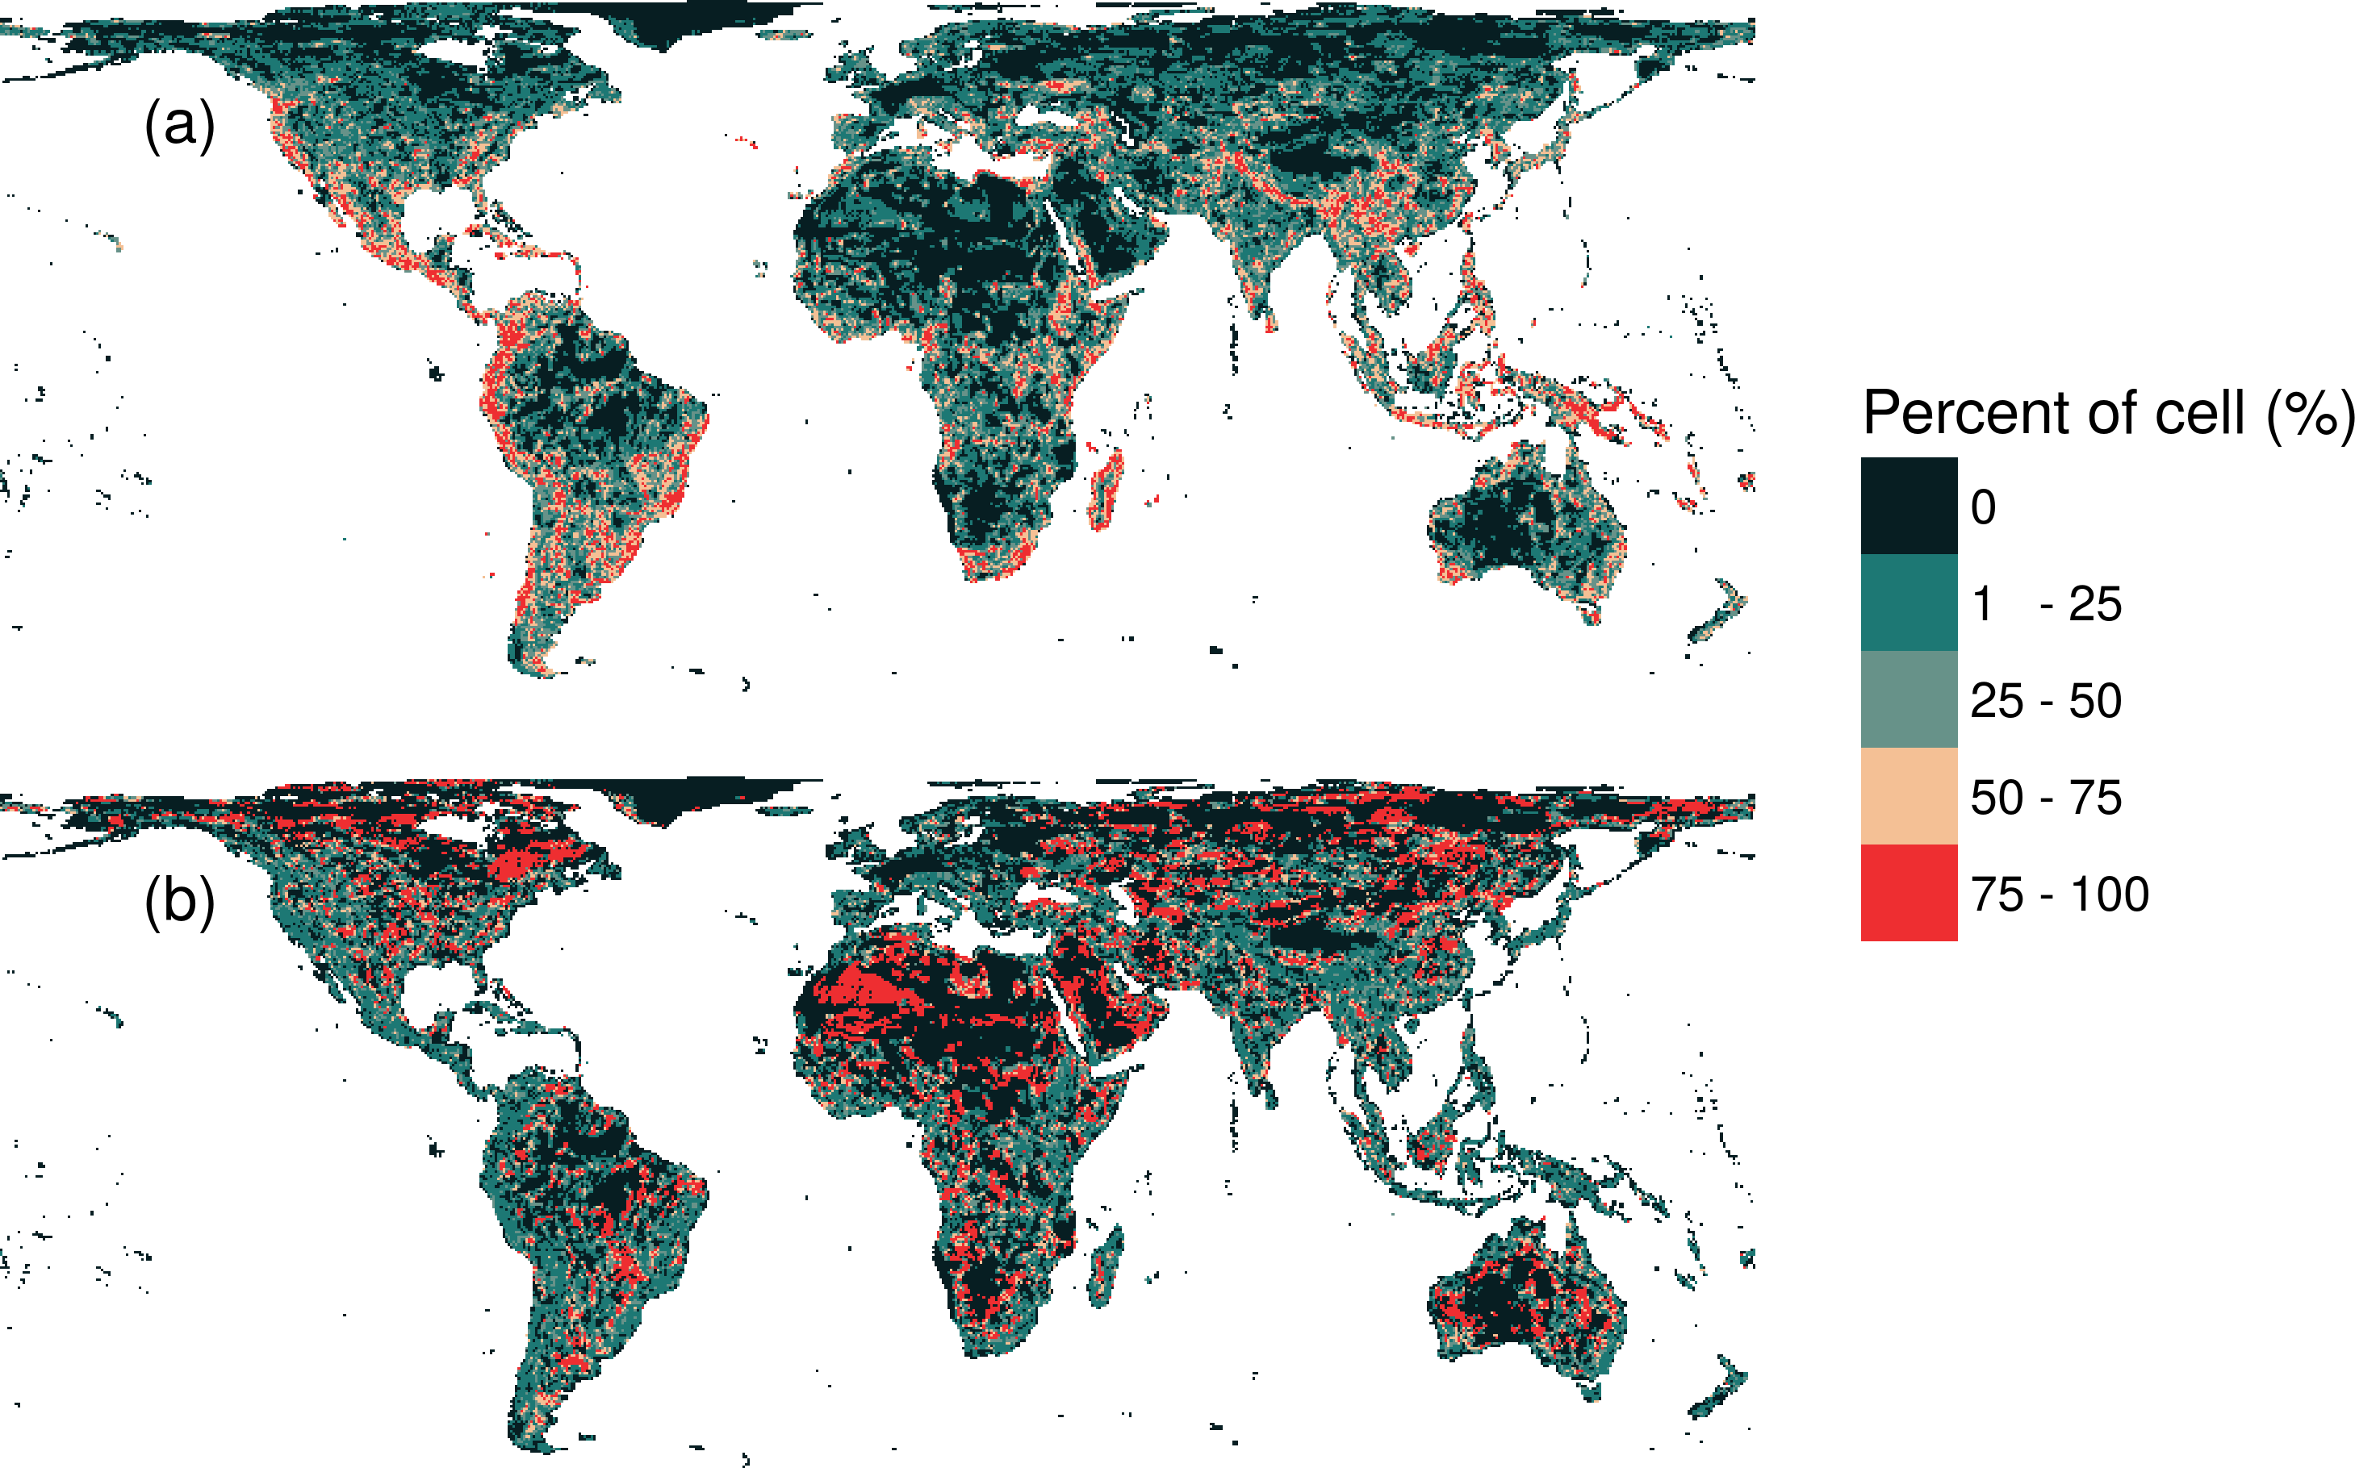
What if we ignore species’ niches?
Only 3.7% less of the Earth’s land than prioritization which considers niches
Fails to adequately represent 7,989 (40%) species
Hanson et al. 2020 Nature

Slide 61
How can we get a better conservation decision?
(1) Better algorithms
(2) Better data
(3) Better surrogates
(4) Other stuff too!

Slide 62
Ecological surveys
Distribution maps
Priority areas
Biodiversity
2000
Future
Data
Information
Plan
Outcome
Objectives
Constraints

Slide 63




jeffrey.hanson@uqconnect.edu.au
github.com/jeffreyhanson
jeffrey-hanson.com

Slide 64
Appendix

Slide 65
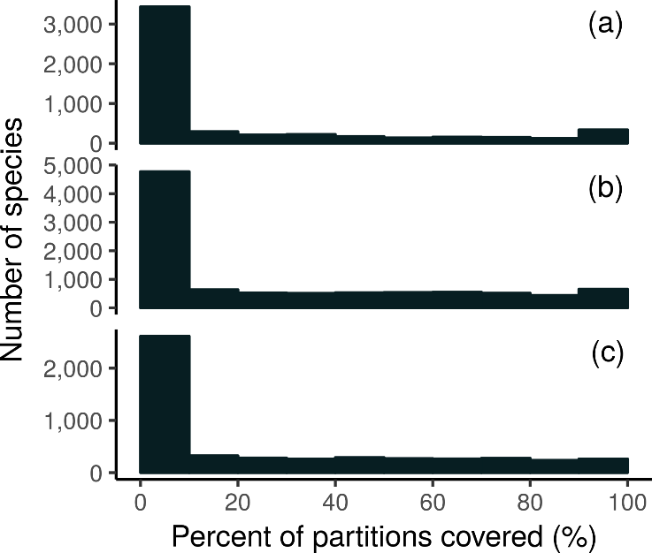
How good is the existing protected system?
18,688 (94%) species are not adequately represented in reserves
8,921 (45%) species do not have a single partition adequately represented
Of these 8,921 species, 2,266 species are globally imperilled
Amphibians
Birds
Mammals
Hanson et al. 2020 Nature

Slide 66
However, surrogates may not always work

Slide 67
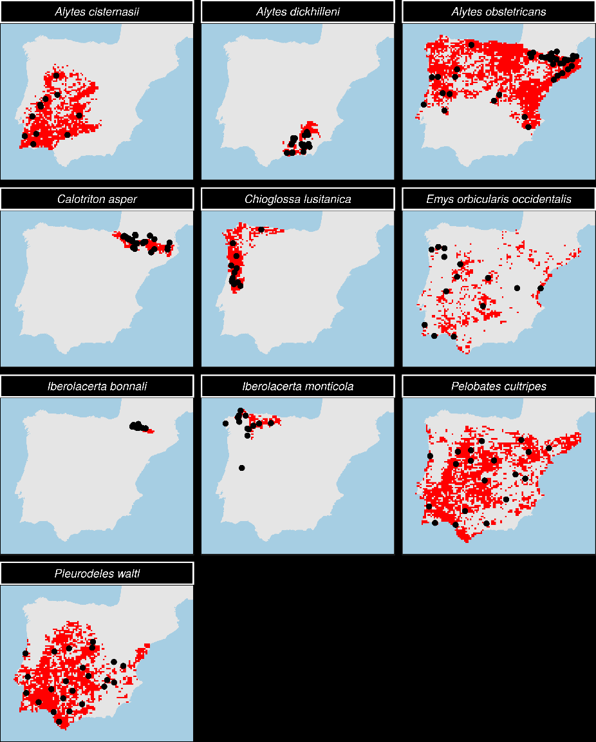
Evaluating surrogates of genetic diversity for conservation planning
7 amphibian species
3 reptile species
Iberian Peninsula =
HARD MODE
Microsatellite markers
Hanson et al. 2020 Cons Biol

Slide 68
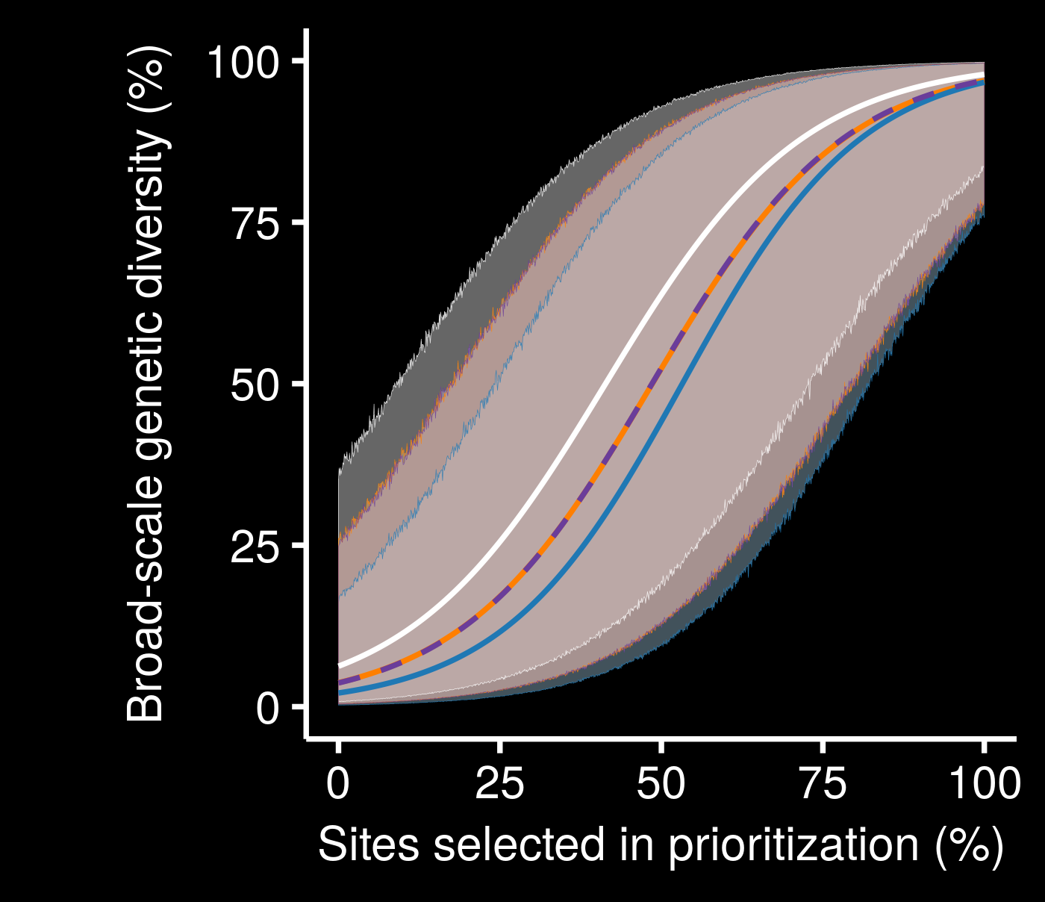
Surrogates may not perform much better than random
Not really a consistent relationship between different species
Very little performance improvement with low budget
genetic
geographic
random
resistance
Hanson et al. 2020 Cons Biol

